Slide 1
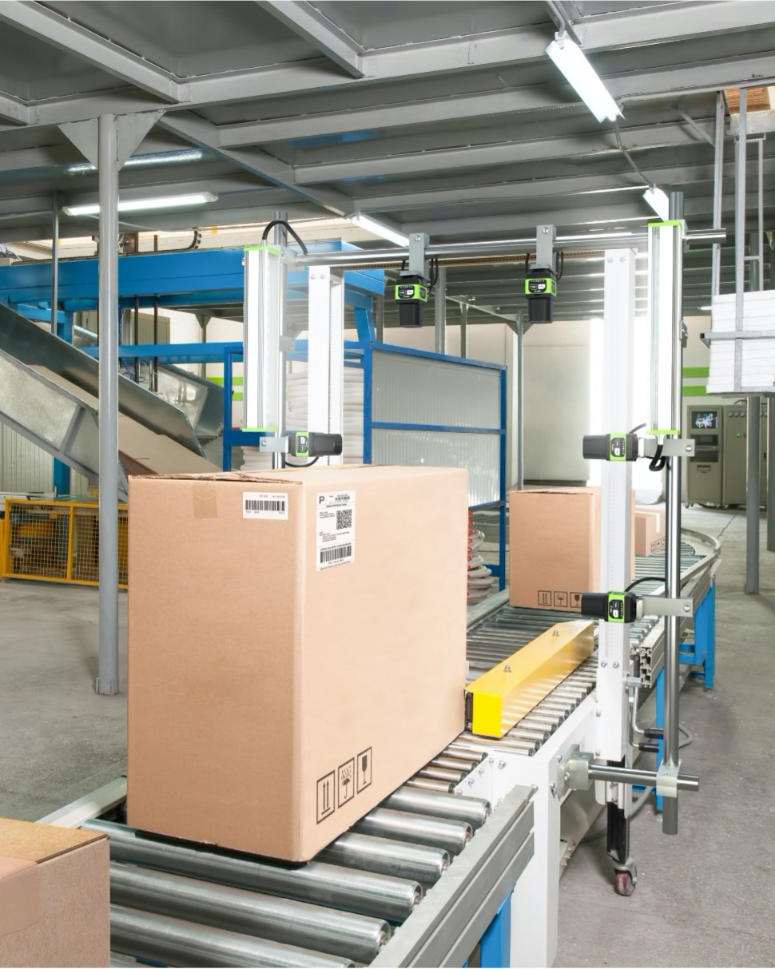
Zebra Warehouse Solutions
Scan Tunnels

Slide 2
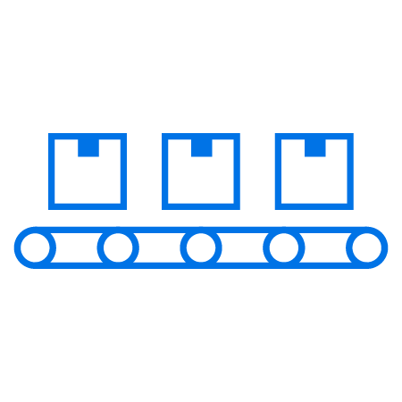
Agenda
Zebra warehouse solutions: Scan tunnels
Challenges in the warehouse
  Today’s supply chain is complex
  Warehouse operations must keep pace
  What do you need to solve to get to where you want to be?
Scan tunnels
  How do they work? Why a use a scan tunnel? What can they help you achieve?
Why choose Zebra to build your scan tunnel?
  How our solutions stand apart
  Benefits of our scan tunnel solutions
The sure path to smarter warehousing

Slide 3
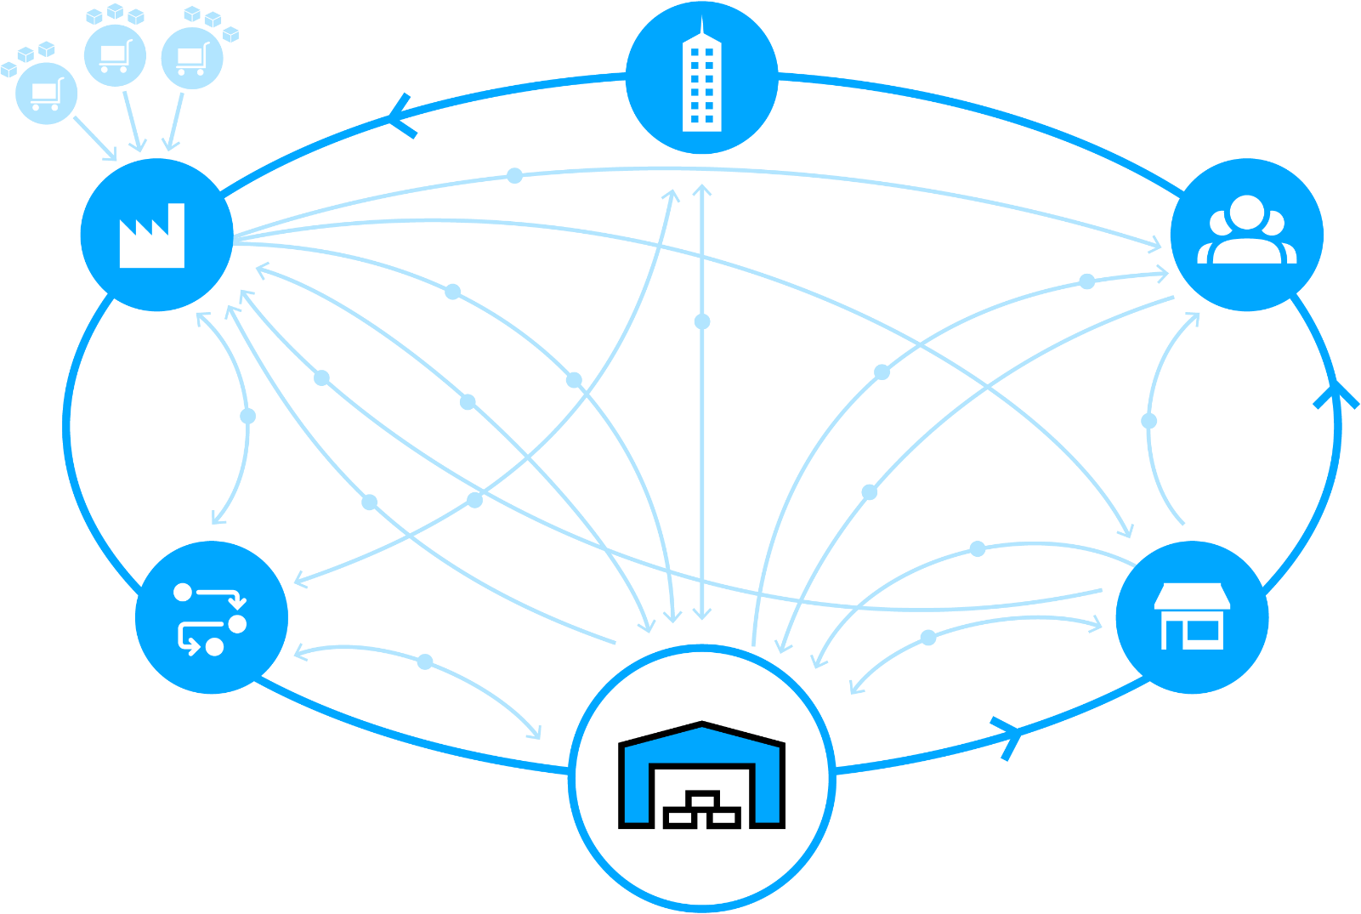
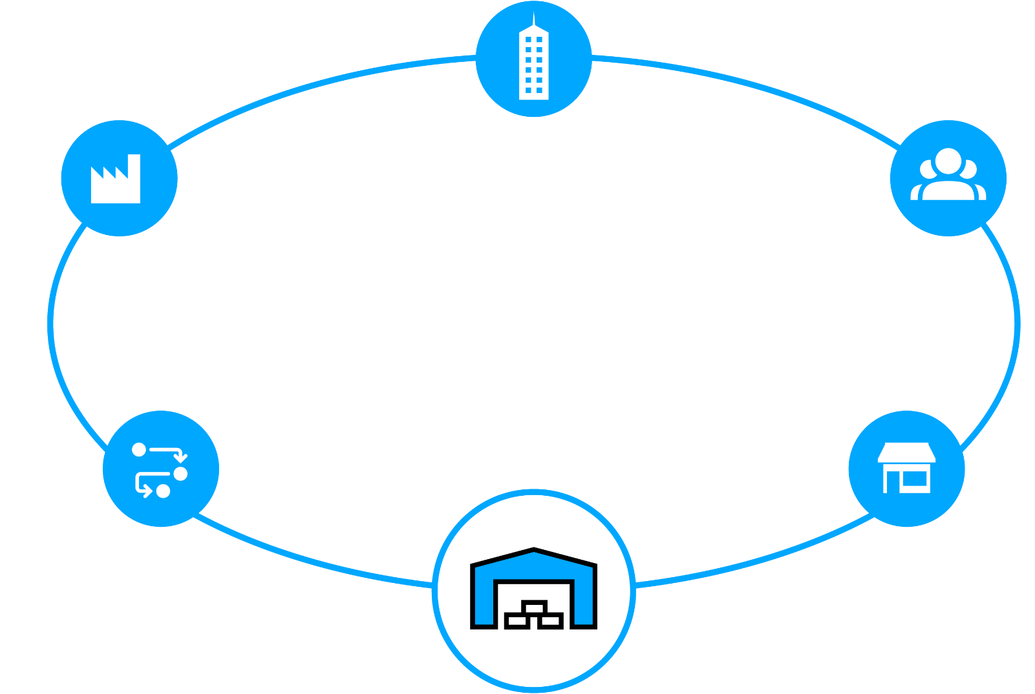


Today’s Supply Chain is Complex
Satisfying customers is no simple matter
Retail or Wholesale Customer
Service and Corporate Operations
New shipping mandates
Suppliers
Raw Materials
Ship direct to customer
Manufacturer
Plant / Warehouse
Finished goods
Customer
Ship to store
Real time
Inventory status
Rush orders
Real time
Inventory status
Real time
item status
Pick-up in
store
Returns
Pallet shipping
Ground orders
Shipment from
closest location
Returns
Real time
Inventory status
Returns
Returns
Real time
Inventory status
Real time
Inventory status
Third-Party
Logistics
Store
Ship to store
Warehouse / Distribution Center / Fulfillment Center

Slide 4

Warehouse Operations
Must Keep Pace
By solving today’s challenges
Isolated systems and visibility gaps
Labor shortages and more volume
  ~50% of all warehouse labor invested in picking operations
Disconnected workers and workflows
  Annual warehouse turnover rates are 30+%
Bottlenecks and asset inventory
blind spots
Rising workflow complexity
Errors and non-compliance are costly
  Onboarding workers may involve a
  90-day ramp up

Slide 5
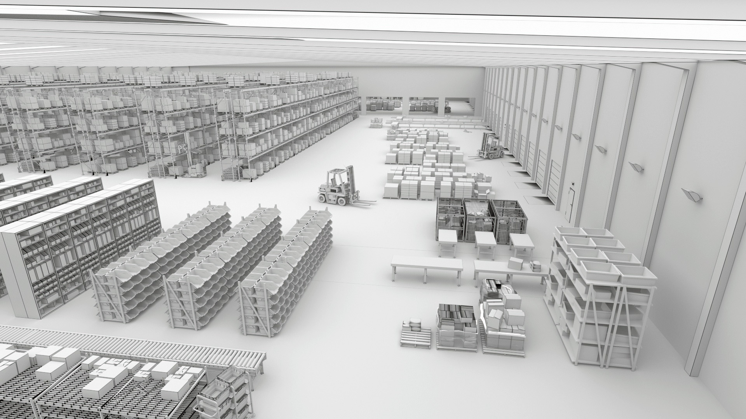
What Do You Need To Solve To Get To Where You Want To Be?
Reduced labor force
Streamlining picking
Turning around
outbound processes
61%
60%
86%
Plan to rely on a combination of humans and technology by 2024
View labor efficiency and productivity as a top challenge
Plan to increase volume of items shipped by 2024
Reducing inbound
congestion
Swiftly handling returns
83%
81%
Plan to have increased number of SKUs by 2024
Plan to expand
returns management operations by 2024
Warehousing Vision Study, Zebra Technologies, 2019.

Slide 6
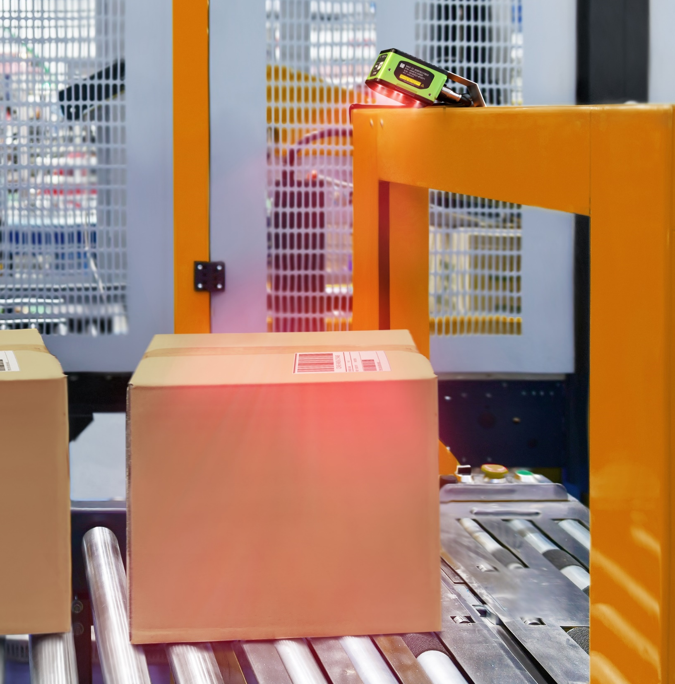
Zebra Warehouse Solutions: Scan Tunnels
How do they work?
One or more scanners or smart cameras are mounted to a gantry that spans the conveyor line
  The array of high-tech cameras capture all sides of a parcel, reading barcodes and other machine-readable text
As items move through the scan tunnel, the system captures data in real-time
  Intelligent software decodes data stored in barcodes to route
  packages appropriately

Slide 7
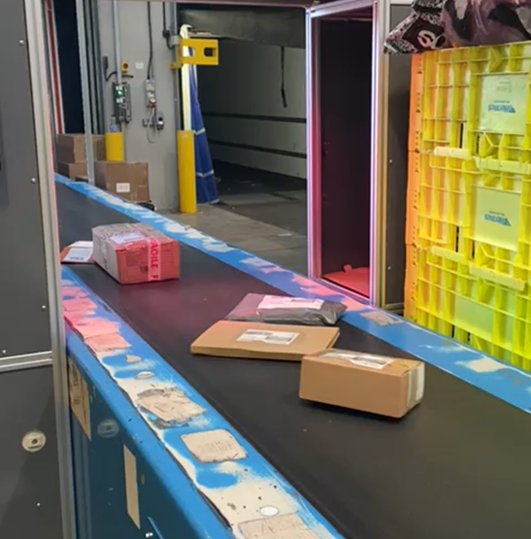
Zebra Warehouse Solutions: Scan Tunnels
Why a use a scan tunnel?
Capture data reliably without stopping goods regardless of:
  Package size
  Package orientation
  Label location
  Number and type of labels

Slide 8
Zebra Warehouse Solutions: Scan Tunnels
What can they help you achieve?
Better barcode reading and verification: Accurate code and label reading is crucial for tracking, tracing and inventory management. Scan tunnels quickly verify barcode accuracy, preventing errors in shipping and logistics
Improved product inspection: Scan tunnels can help with quality control and compliance, inspecting items for defects, contamination, or damage and automatically diverting
problematic products from production lines
Labor reduction and cost savings: Scan tunnels reduce the need for manual inspection
and handling, leading to cost savings and increased throughput

Slide 9
Why Choose Zebra To Build Your Scan Tunnel?
How our solutions stand apart
Proven high-speed barcode reading with unmatched accuracy that improves efficiency and overall throughput
Powerful software to read and decode OCR, barcodes, dimensional information and label defects
Cost effective, customizable solutions
Rugged design to sustain harsh environments and reduce maintenance and down-time
Innovative sensors and smart cameras available in various sizes to accommodate any field of view
Seamless integration with existing automation equipment
Easily pair with other Zebra devices such as mobile computers and industrial printers for a single-source solution
Trust an award-winning partner ecosystem who are experts in vison technology

Slide 10
Boosting Warehouse Productivity With Zebra
Benefits of our scan tunnel solutions
4x faster image acquisition with Zebra devices compared to leading competitors
Scanner frame rates up to 60 fps enable higher-speed conveyor systems, capturing image and decoding barcodes at high speed, using ImagePerfect and PRZM Intelligent imaging software tools
ImagePerfect+ captures 16 data points from a single trigger, saving time and resources
Liquid lenses offer technological advantages over traditional mechanical lenses. Designed to focus across variable working distances, liquid lens facilitate the use of ImagePerfect+ and deliver dependably high read rates
Easier troubleshooting and optimization with features like Golden Image Compare and a feasibility setup assistant. Minimize downtime and ensures that captured images meet best practice metrics, leading to more efficient operations
Best-practice metrics are visible from Zebra’s feasibility setup assistant for automatic assessment of captured images and optimization recommendations
Notes:
When a barcode or image capture fails, this unique Zebra-only tool minimizes downtime and the impact on the production line with rapid troubleshooting and issue resolution. In just two clicks, you can view the failed image and a golden image created at set up, side by side, revealing the course of the issue – from a dirty lens or a lighting problem to misalignment of the camera.
This patent-pending feature ensures the selected tools and settings will work before jobs are deployed. Automatically compares images captured from a job to best practice metrics and recommends changes to ensure application settings are optimal.

Slide 11
The Sure Path to Smarter Warehousing
From gaining basic control of operations to achieving predictability and
adaptability, let us help guide your journey with a new standard for accelerating warehouse modernization
Your way forward starts with:
1
Decades of field-proven innovation in warehousing
An outcome-driven approach based on your strategic journey
A focus on continuous improvement of your business
A comprehensive portfolio to configure the right technology solution for your operations
An extensive partner network to support every aspect of your journey—as you control and set the pace
2
3
4
5

Slide 12
For more information, please visit zebra.com to learn more

Slide 14
APPENDIX
Product-specific slides if needed

Slide 15
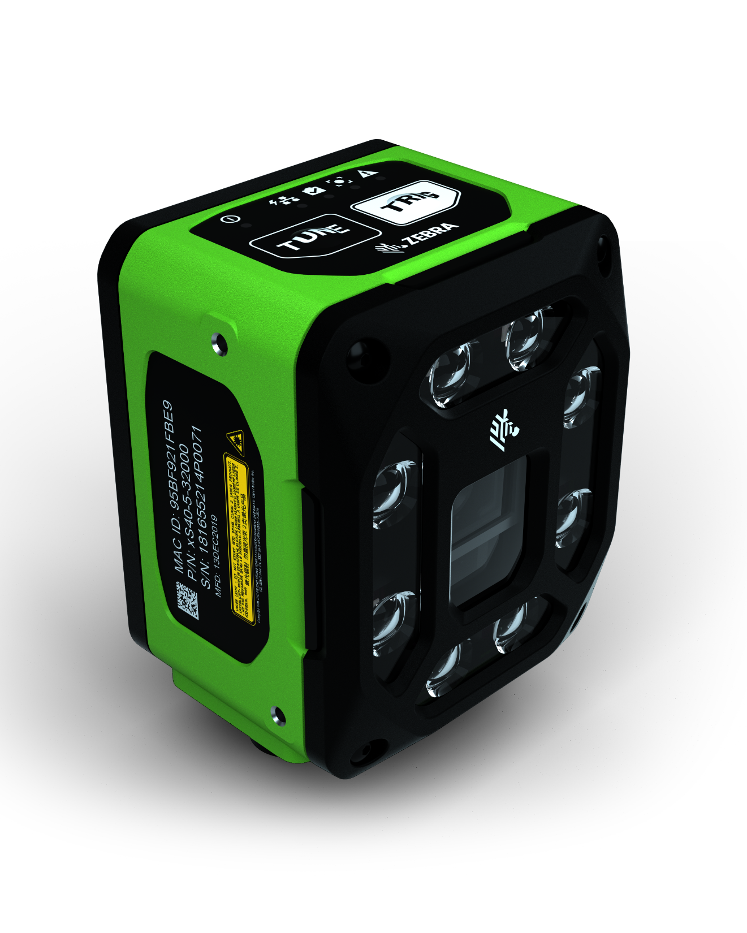
Building Your Scan Tunnel
FS40 fixed industrial scanners
First-time every-time high-speed capture of barcodes and DPMs in any condition
Pair with Aurora Focus software to set up, control and run the device
Easy license upgrades to add on decoder packages and machine vision toolsets to build your dock door solution
PoE connectivity to reduce need for peripheral equipment

Slide 16
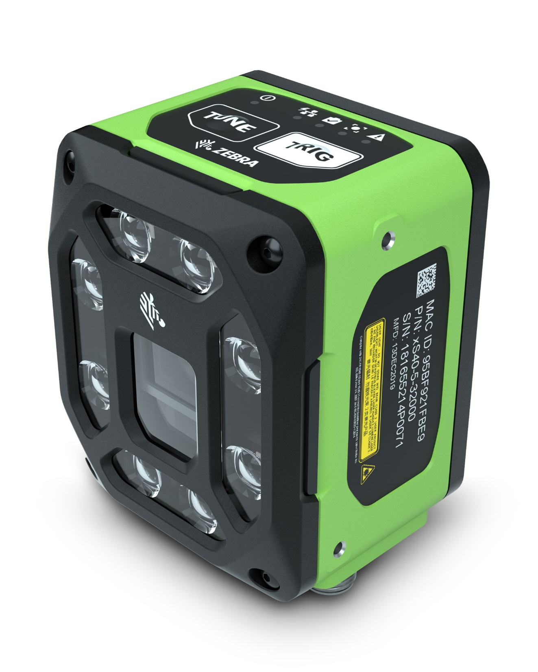
Building Your Scan Tunnel
VS40 smart cameras
Capture up to 16 unique high-speed images with ImagePerfect+ and eliminate false rejects
Troubleshoot failed image captures immediately with Golden Image Compare
Pair with Aurora Focus software to set up, control and run the device
Upgradeable software to easily add support for new symbologies, faster speeds or machine vision toolsets

Slide 17
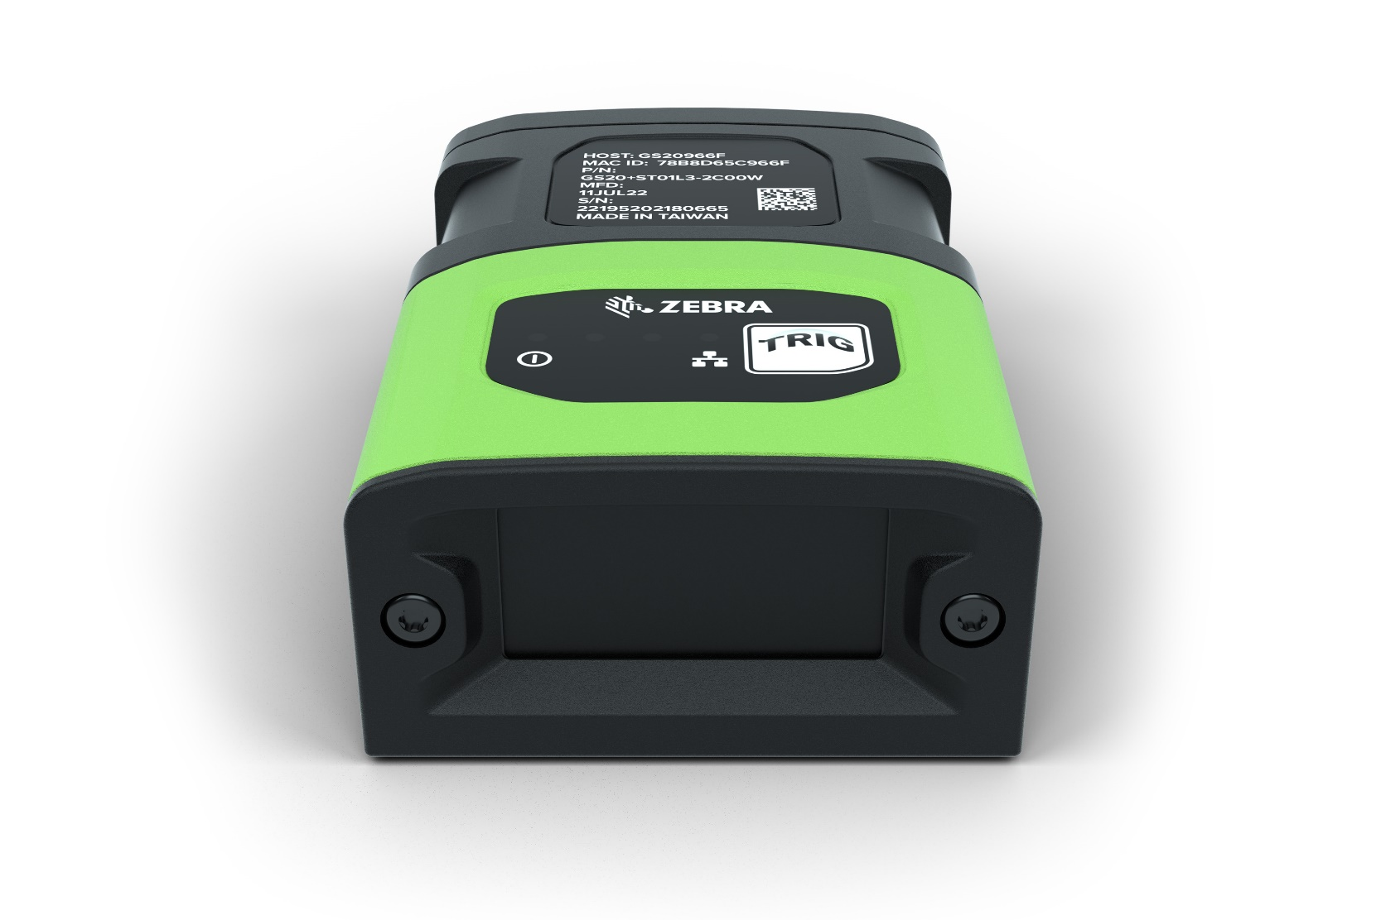
Building Your Scan Tunnel
GS20 connectivity gateway devices
Supports up to 16 cameras—more than any other competitor
Flexible configuration supports a variety of package sizes and label orientations
Integrated web-based HMI graphical interface for easy set-up and data capture
Built-in support for Rockwell, Siemens, Mitsubishi and Omron PLC devices simplifies integration and cost
Pair with Aurora Focus software for easy setup and control

Slide 18
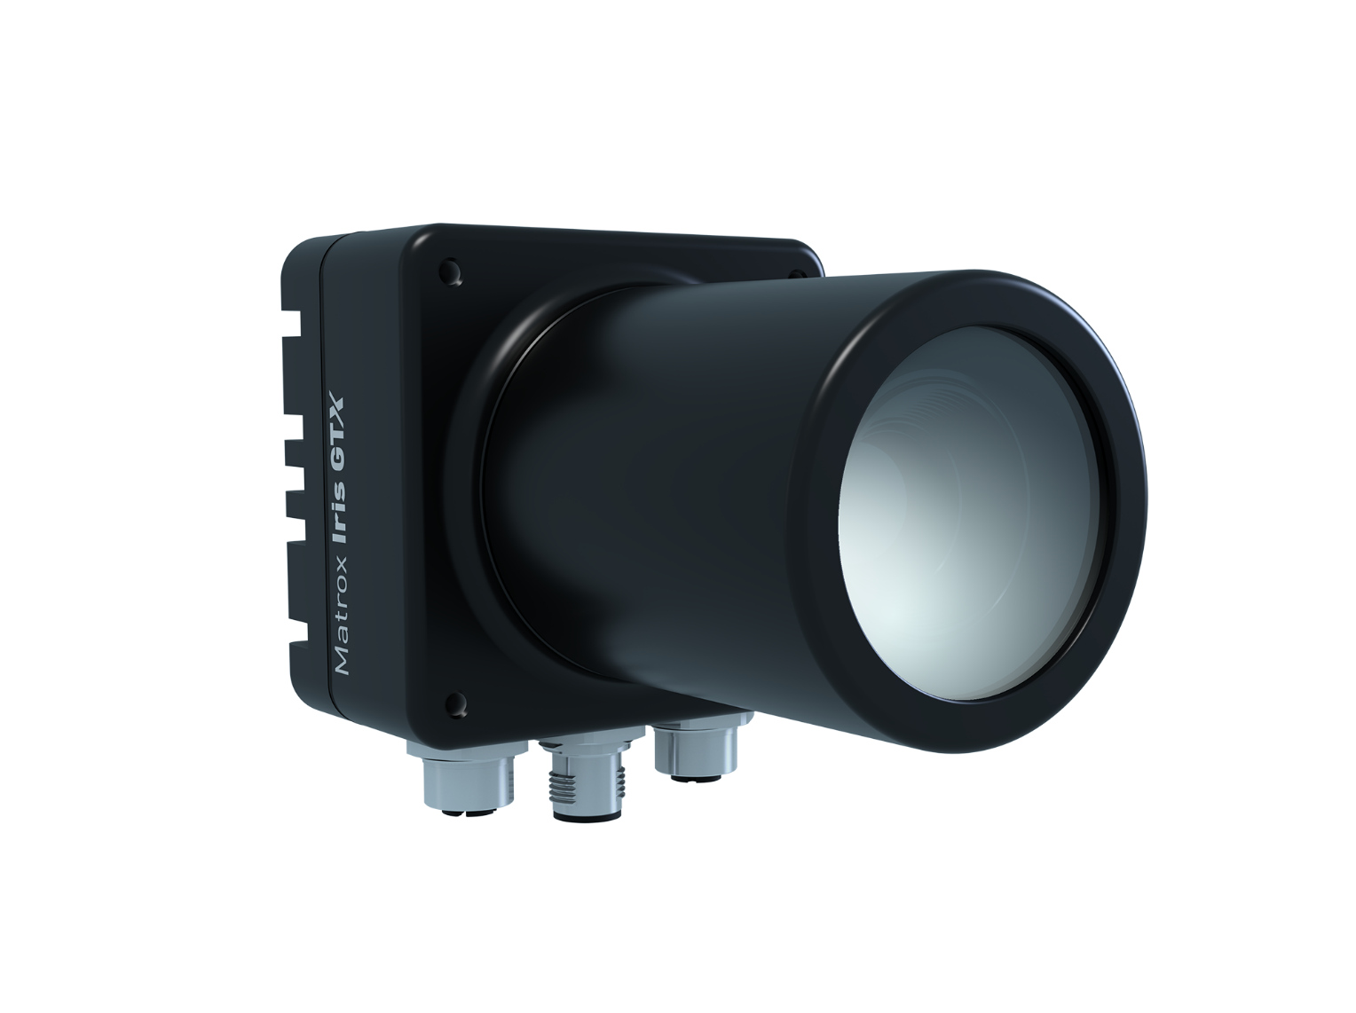
Building Your Scan Tunnel
Iris GTX smart camera
On-device image acquisition and analytics with direct communication to automation devices
Real-time digital I/Os, GigE and USB ports, and VGA output for full integration with automation cells or machines
Pair with Aurora Design Assistant to form all-in-one vision system
High-speed sensors (from 2 to
16 MP) for optimal scan tunnel capture capabilities

Slide 19
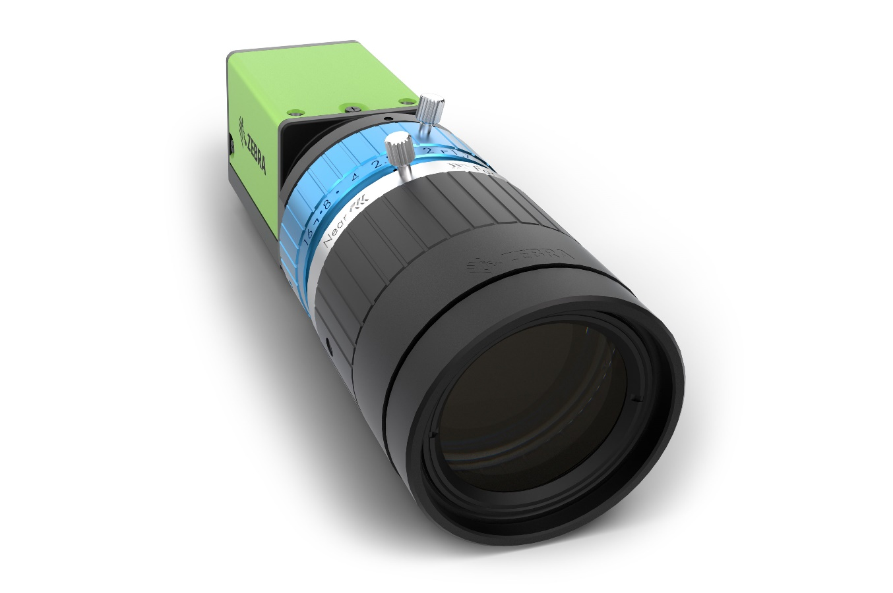
Building Your Scan Tunnel
CV60 machine vision camera
Color and monochrome options for multi-camera inspections
High-resolution CMOS sensors (from 2.3 to 12.3 MP) and a standard GigE Vision interface
Industrial grade shock and vibration ratings, excellent thermal dissipation, and outstanding reliability for maximum scan tunnel uptime

Slide 20
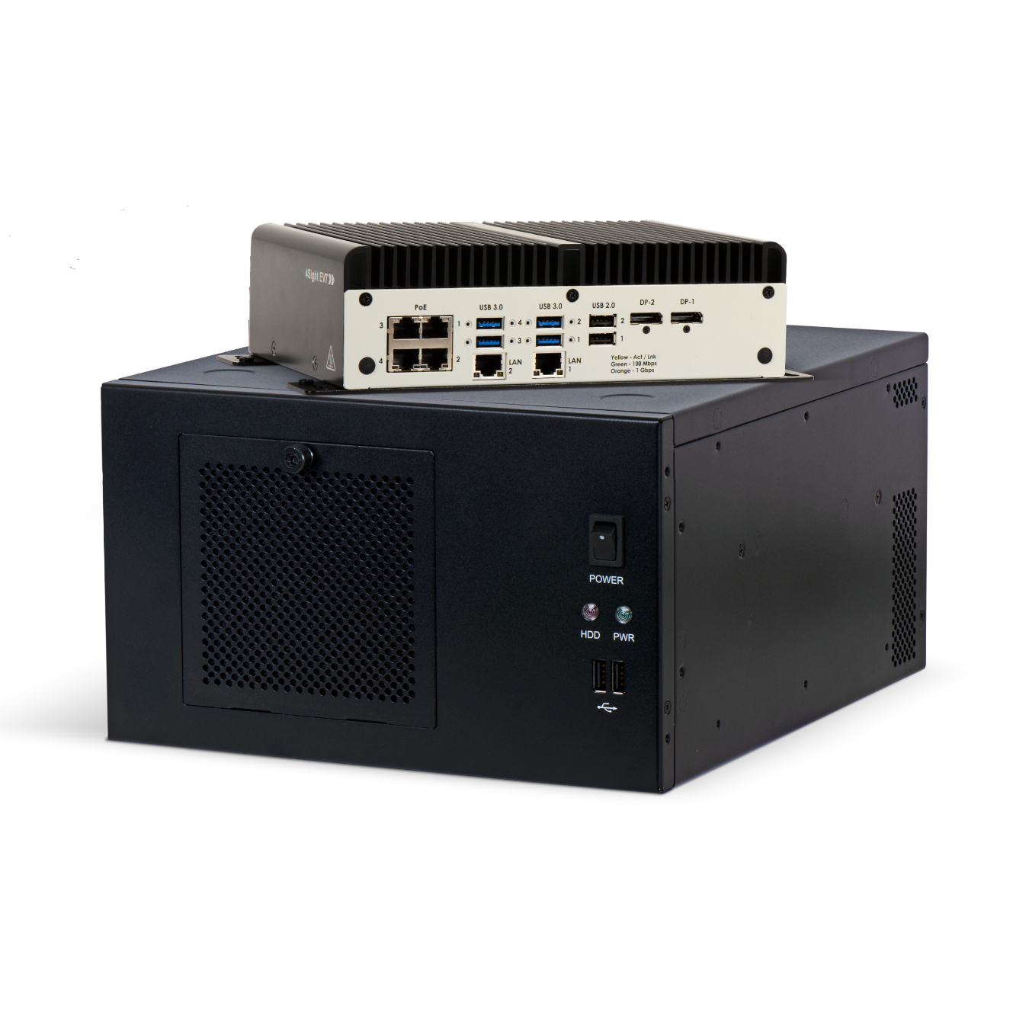
Building Your Scan Tunnel
4Sight series vision controllers
Rugged models purpose-built for warehouse environments
Power single high-rate or multi-camera applications
Desktop-level performance and substantial expansion capabilities
  Pair with Zebra frame grabbers to customize image acquisition, network interface, processing offload, and acceleration needs
Suitable for traditional machine vision and deep learning inference

Slide 21

Building Your Scan Tunnel
Aurora Focus software
Ready-made for barcode reading and verification, OCR, and presence/absence vision inspection
  Purpose-built to scan and compare barcodes to determine code quality and assess if quality impacts scan ability
Deploy directly from FS scanners and VS smart cameras
Intuitive interface designed to make it easy to build, deploy and adjust jobs, and configure scanner connections

Slide 22

Building Your Scan Tunnel
Aurora Design Assistant software
Flowchart-based drag-and-drop development environment means no need for coding
  Included templates speed up development and deployment time
Hardware independent and pairs with branded and third-party smart cameras, vision controllers, and PCs with CoaXPress, GigE Vision, or USB3 Vision cameras
Real-time discrete I/Os for communicating actions and results to automation and enterprise equipment

Slide 23

Building Your Scan Tunnel
Aurora Vision Studio
Dataflow-based software with an intuitive
graphical environment that helps users develop vision systems much faster than with low-level programming
Workflow broken into 3 parts:
  Select filters using the provided toolbox and connect them in a visual editor
  Set parameters dragging and dropping filter outputs
  Connect filters in the data-flow editor and run the program

