Slide 1
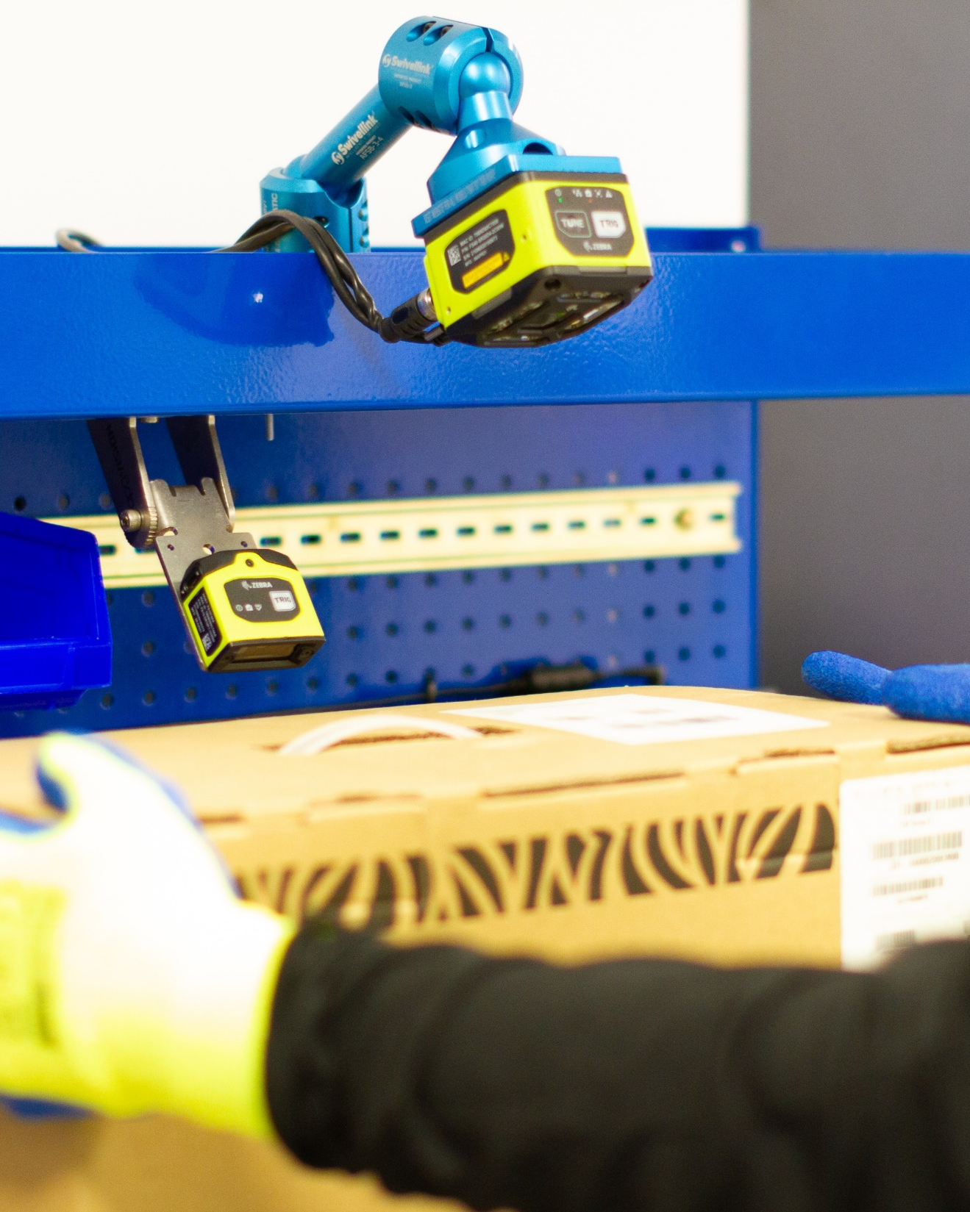
Zebra Warehouse Solutions
Packing Bench

Slide 2

Agenda
Zebra warehouse solutions: Packing bench
Challenges in the warehouse
  Today’s supply chain is complex
  Warehouse operations must keep pace
  What do you need to solve to get to where you want to be?
Packing bench
  How does it work? What can it help you achieve?
Why choose Zebra to build your packing bench?
  How our solutions stand apart
  Benefits of our packing bench solutions
The sure path to smarter warehousing

Slide 3
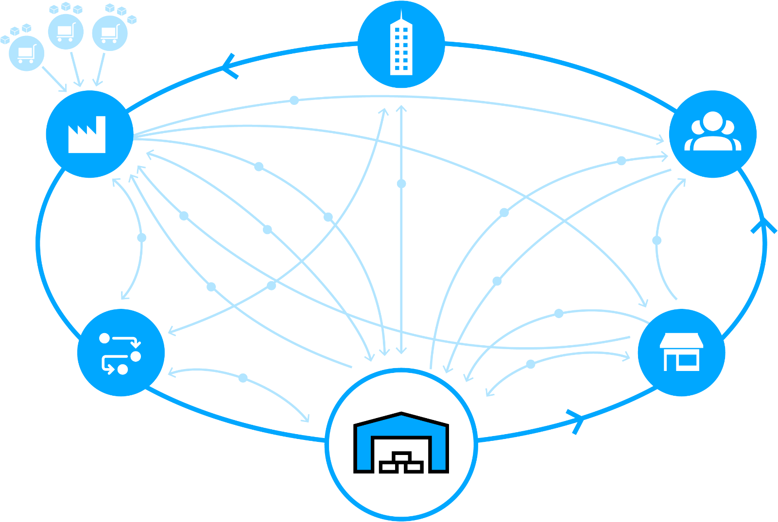
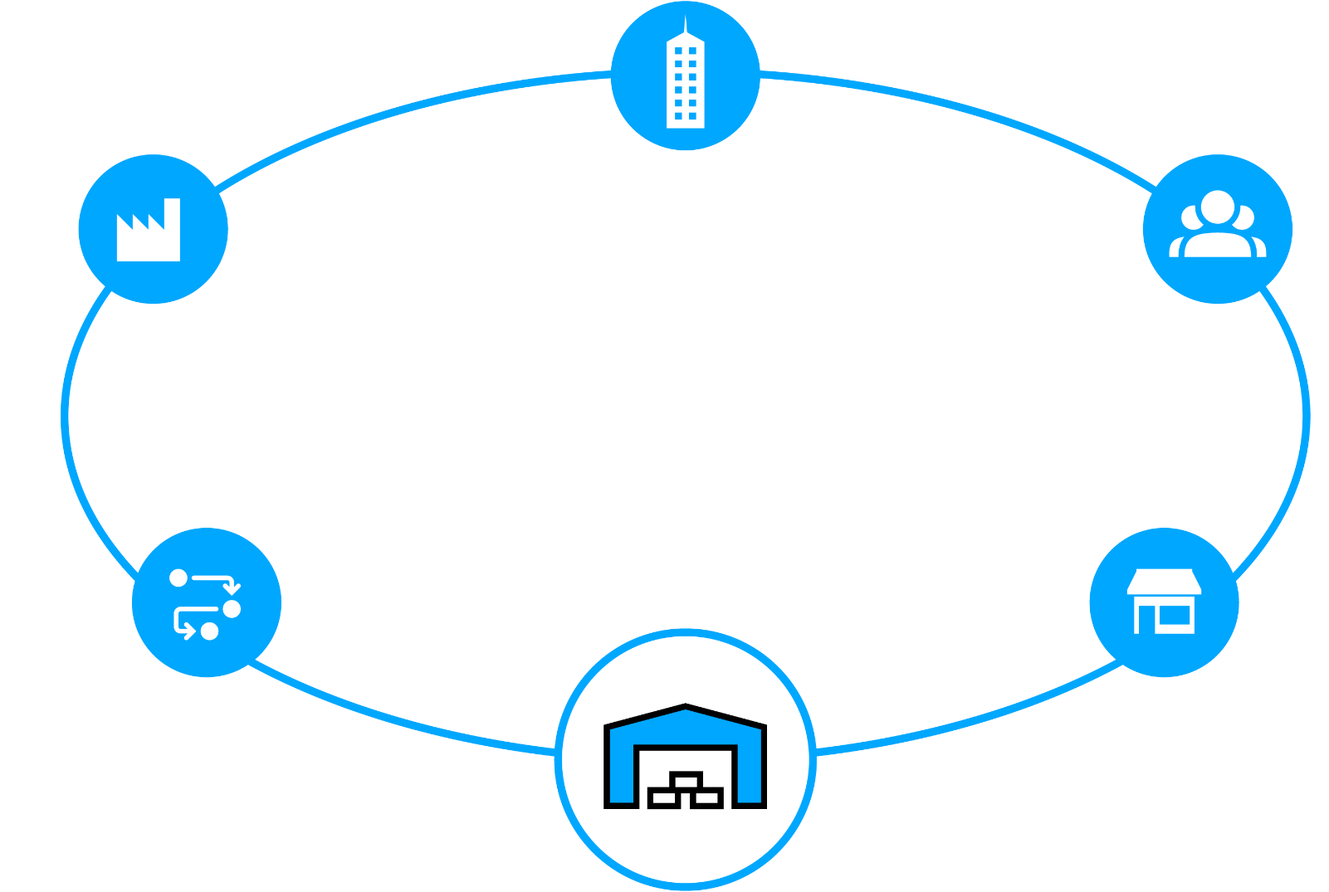


Today’s Supply Chain is Complex
Satisfying customers is no simple matter
Retail or Wholesale Customer
Service and Corporate Operations
New shipping mandates
Suppliers
Raw Materials
Ship direct to customer
Manufacturer
Plant / Warehouse
Finished goods
Customer
Ship to store
Real time
Inventory status
Rush orders
Real time
Inventory status
Real time
item status
Pick-up in
store
Returns
Pallet shipping
Ground orders
Shipment from
closest location
Returns
Real time
Inventory status
Returns
Returns
Real time
Inventory status
Real time
Inventory status
Third-Party
Logistics
Store
Ship to store
Warehouse / Distribution Center / Fulfillment Center

Slide 4
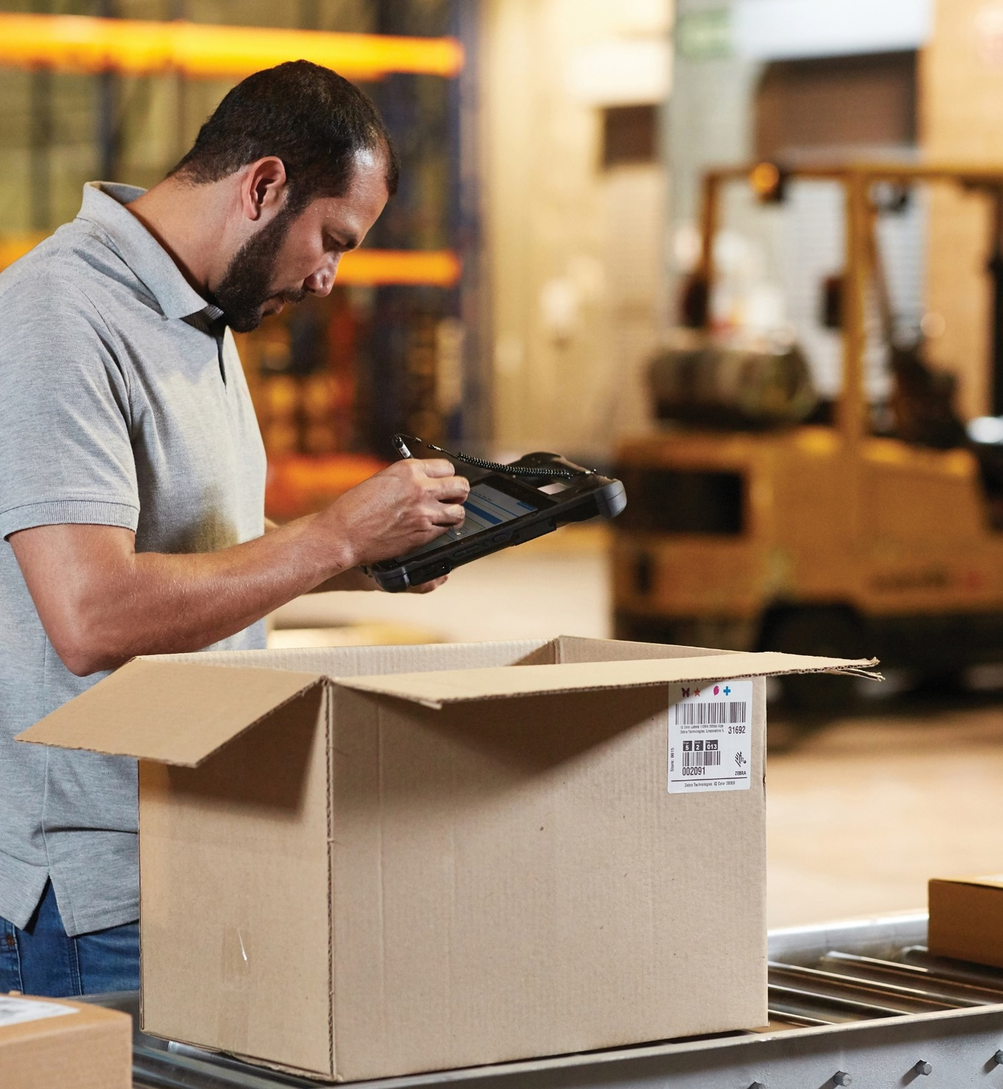
Warehouse Operations
Must Keep Pace
By solving today’s challenges
Isolated systems and visibility gaps
Labor shortages and more volume
  ~50% of all warehouse labor invested in picking operations
Disconnected workers and workflows
  Annual warehouse turnover rates are 30+%
Bottlenecks and asset inventory
blind spots
Rising workflow complexity
Errors and non-compliance are costly
  Onboarding workers may involve a
  90-day ramp up

Slide 5
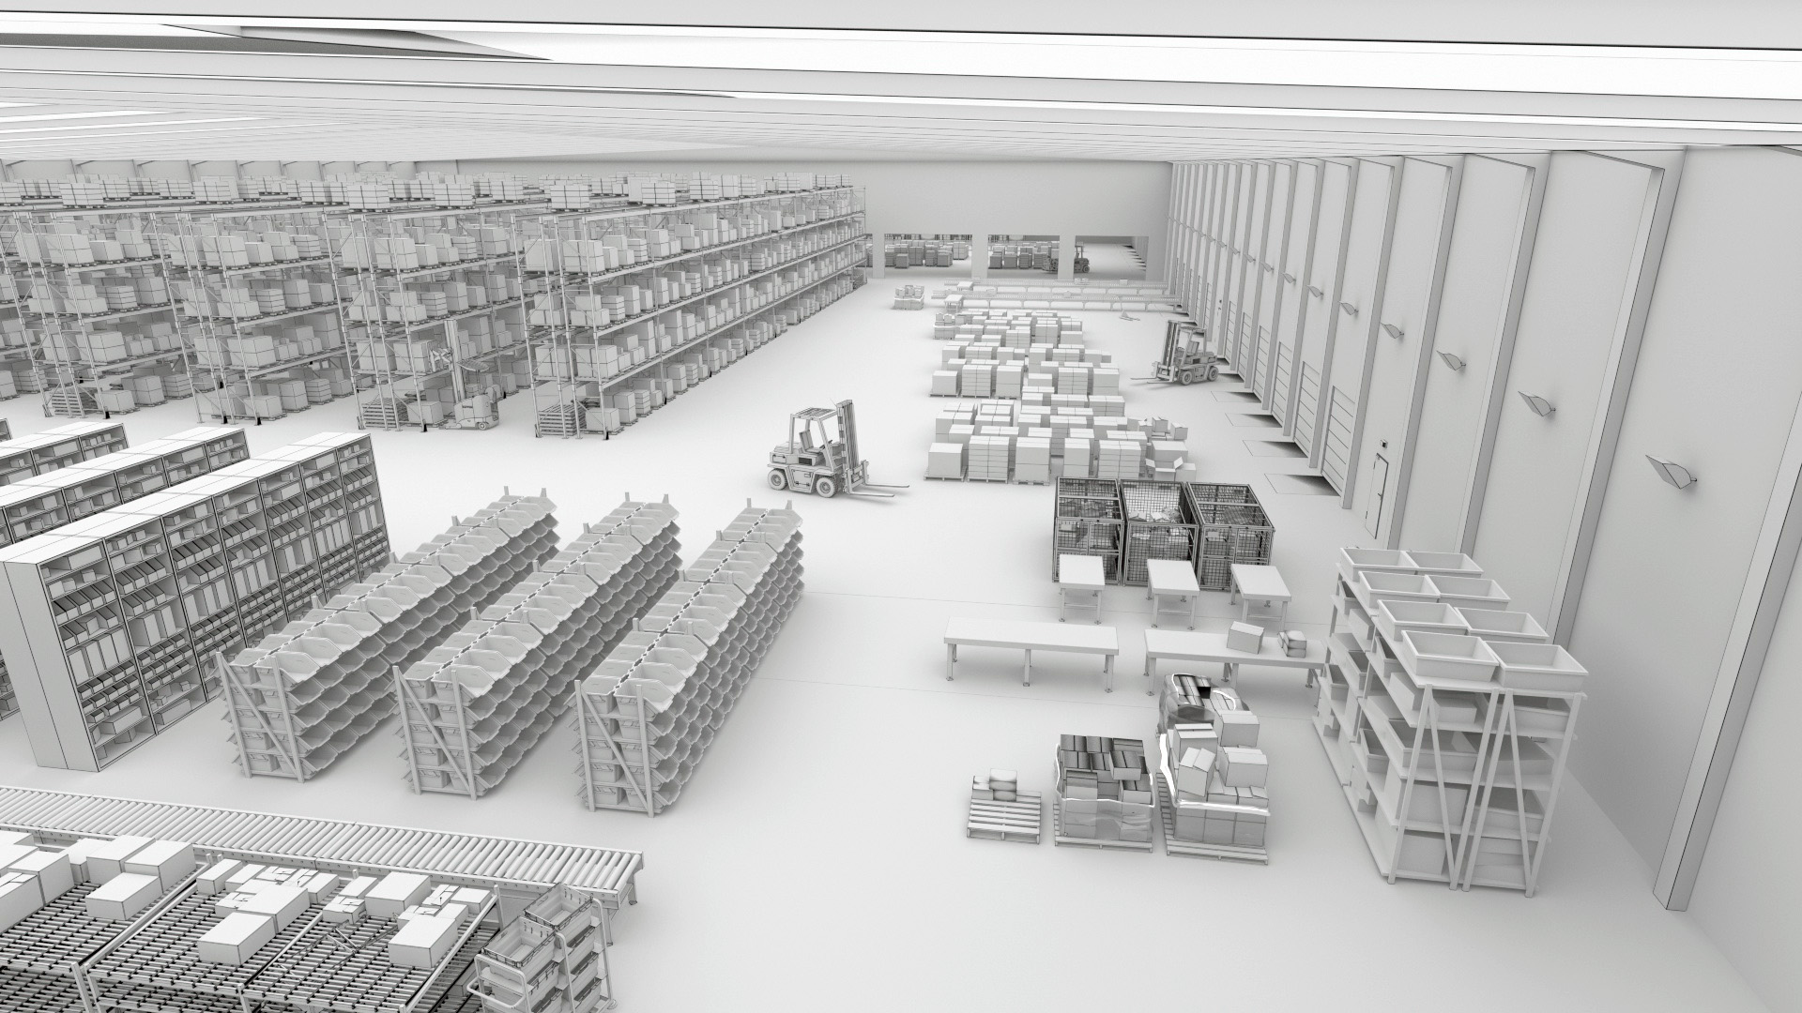
What Do You Need To Solve To Get To Where You Want To Be?
Reduced labor force
Streamlining picking
Turning around
outbound processes
61%
60%
86%
Plan to rely on a combination of humans and technology by 2024
View labor efficiency and productivity as a top challenge
Plan to increase volume of items shipped by 2024
Reducing inbound
congestion
Swiftly handling returns
83%
81%
Plan to have increased number of SKUs by 2024
Plan to expand
returns management operations by 2024
Warehousing Vision Study, Zebra Technologies, 2019.

Slide 6
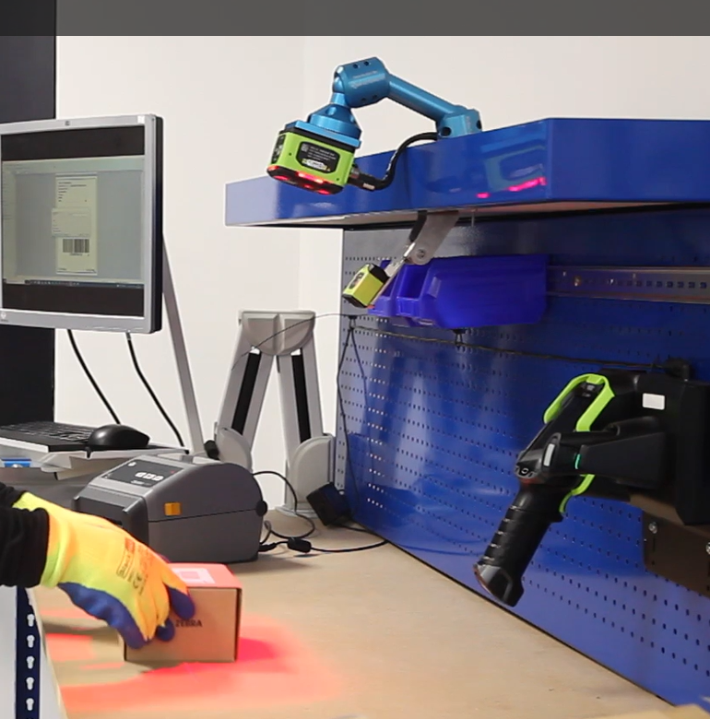
Zebra Warehouse Solutions: Packing Bench
How does it work?
A fixed industrial scanner and a smart camera are mounted over the packing station to capture real-time data
The operator places a box under the scanner, which will flash green and beep, providing visible and audible cues for successful decodes
  Plug scanners directly into the USB port
  of a workstation, laptop, tablet or other
  host device to begin capturing barcode
  data immediately
  FS40 scanners also connect directly to handheld devices for even faster
  operations

Slide 7
Zebra Warehouse Solutions: Packing Bench
What can it help you achieve?
Greater efficiency: Adding fixed industrial scanners and machine vision technology to existing warehouse processes improves inspection capabilities like volume verification and package integrity assessment
Better speed and productivity: Packing benches streamline high-volume warehouse process by automating quality checks and reducing manual inspection time
Reduced labor and material costs: Zebra’s range of print technology supports multiple sizes, speeds and mediums. Linerless printing goes a step further, eliminating the need to peel labels—saving valuable seconds on every pack
Enhanced quality control: Packing errors can result in costly returns and customer dissatisfaction; packing bench solutions minimize errors through automated verification and content validation
Fewer operational errors: Reduced human intervention improves data quality and accuracy, and streamlines operations

Slide 8
Why Choose Zebra To Build Your Packing Bench?
How our solutions stand apart
Proven high-speed barcode reading with unmatched accuracy that improves efficiency and overall throughput
Powerful software to read and decode OCR, barcodes, dimensional information and label defects
Cost effective, customizable solutions
Rugged design to sustain harsh environments and reduce maintenance and down-time
Innovative sensors and smart cameras available in various sizes to accommodate any field of view
Seamless integration with existing automation equipment
Easily pair with other Zebra devices such as mobile computers and industrial printers for a single-source solution
Trust an award-winning partner ecosystem who are experts in vison technology

Slide 9
Boosting Your Warehouse Productivity With Zebra
Benefits of our packing bench solutions
Up to 24% throughput improvement seen in current installations using Zebra packing bench solutions
Zebra’s laser aimers provide better power and visibility than competition LED aimers, which are much less visible and can negatively impact performance outcomes
Reduce cost of ownership by eliminating the need for extra hardware, driving down initial investments and ongoing maintenance expenses
4x faster image acquisition with Zebra devices compared to leading competitors
Top-of-the-line optical quality—enhanced to assess barcode quality and ensure superior image quality at label edges—enables verification and optical character recognition via a simple software license

Slide 10
The Sure Path to Smarter Warehousing
From gaining basic control of operations to achieving predictability and
adaptability, let us help guide your journey with a new standard for accelerating warehouse modernization
Your way forward starts with:
1
Decades of field-proven innovation in warehousing
An outcome-driven approach based on your strategic journey
A focus on continuous improvement of your business
A comprehensive portfolio to configure the right technology solution for your operations
An extensive partner network to support every aspect of your journey—as you control and set the pace
2
3
4
5

Slide 11
For more information, please contact XXX / visit zebra.com to learn more

Slide 13
APPENDIX
Product-specific slides if needed

Slide 14
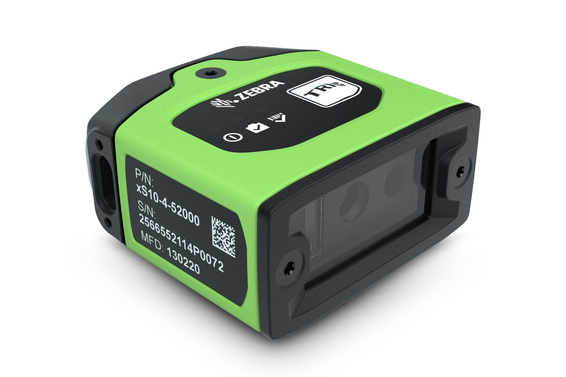
Building Your Packing Bench
FS10 fixed industrial scanners
Purpose-built for barcode scanning, the fit-everywhere device plugs into the USB port of any warehouse host device and deploys in minutes
Pair with Zebra Aurora Focus™ software to set up, control and run the device
ImagePerfect tool captures three different images to optimize reliability
First-time every-time barcode capture with PRZM Intelligent Imaging

Slide 15
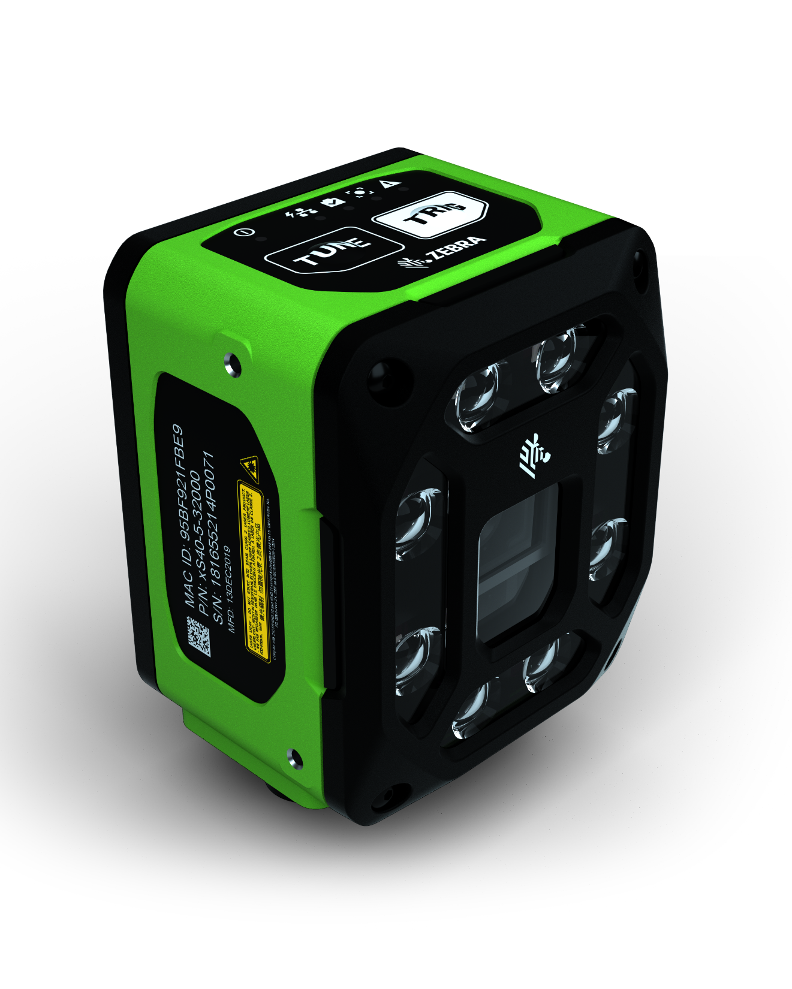
Building Your Packing Bench
FS40 fixed industrial scanners
First-time every-time capture of barcodes and DPMs in any condition at high speeds
Pair with Aurora Focus software to set up, control and run the device
Upgradeable licensing options to add decoder packages and machine vision toolsets to the packing bench solution
PoE connectivity to reduce need for peripheral equipment

Slide 16

Building Your Packing Bench
Aurora Focus software
Ready-made for barcode reading and verification, OCR, and presence/absence vision inspection
  Purpose-built to scan and compare barcodes to determine code quality and assess if quality impacts scan ability
Deploy directly from FS scanners and VS smart cameras
Intuitive interface designed to make it easy to build, deploy and adjust jobs, and configure scanner connections

Slide 17
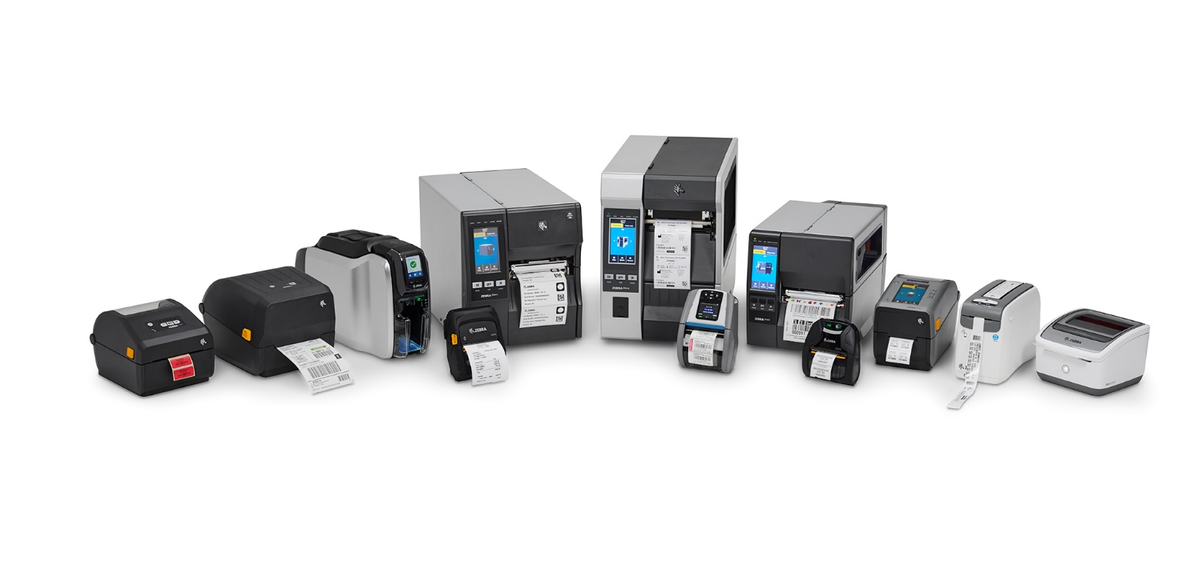
Building Your Packing Bench
Zebra printers
Best-in-class performance
Easy-to-use interfaces requires minimal
training to set up and deploy
Robust tolerance to temperature, humidity,
dust and environmental hazards
Linerless configurations eliminate waste and deliver more labels per roll
Zebra’s Print DNA software facilitates consistent, uninterrupted printing
Fully interoperable devices connect to existing wired and wireless networks or directly to PCs
Flexibility to be used standalone or integrated into other products such as packing benches

