Slide 1
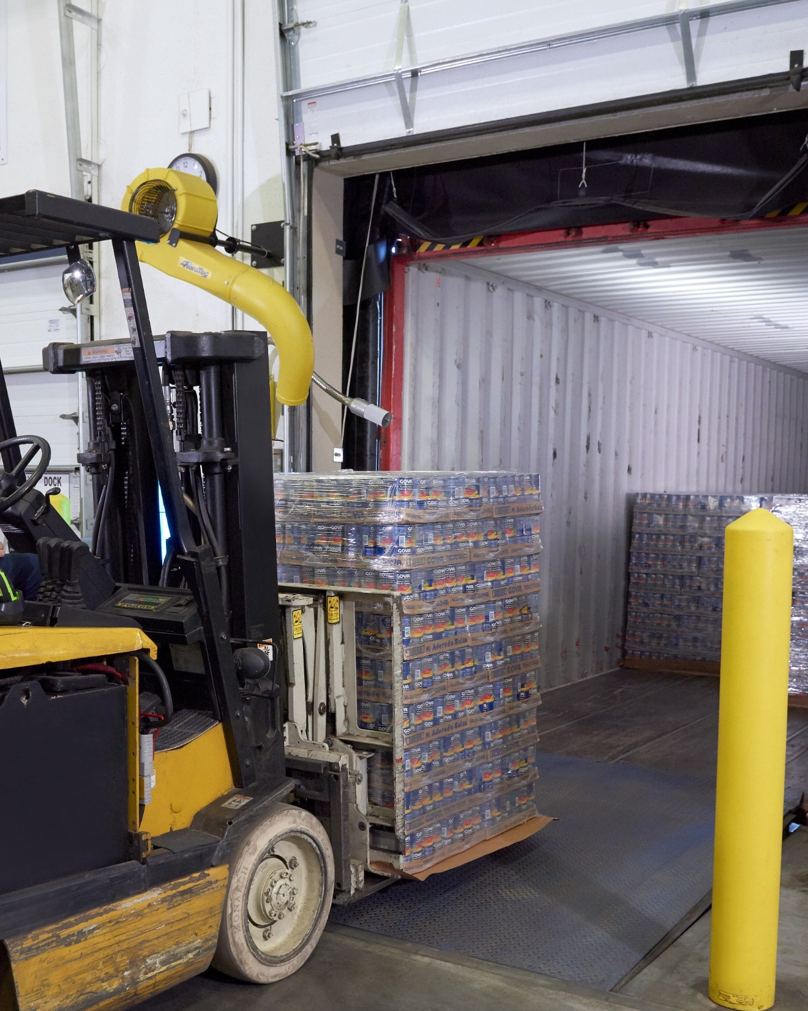
Zebra Warehouse Solutions
Forklift Scanning

Slide 2

Agenda
Zebra warehouse solutions: Forklift scanning
Challenges in the warehouse
  Today’s supply chain is complex
  Warehouse operations must keep pace
  What do you need to solve to get to where you want to be?
Forklift scanning
  How does it work? What can it help you achieve?
Why choose Zebra to build your forklift scanner?
  How our solutions stand apart
  Benefits of our forklift scanning solutions
The sure path to smarter warehousing

Slide 3
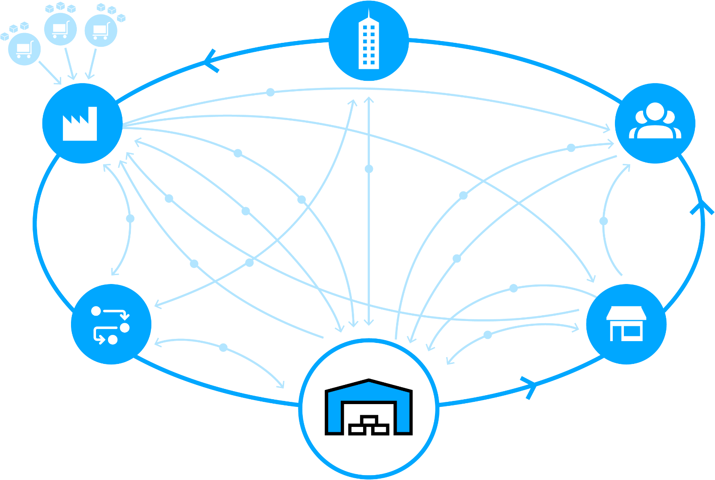
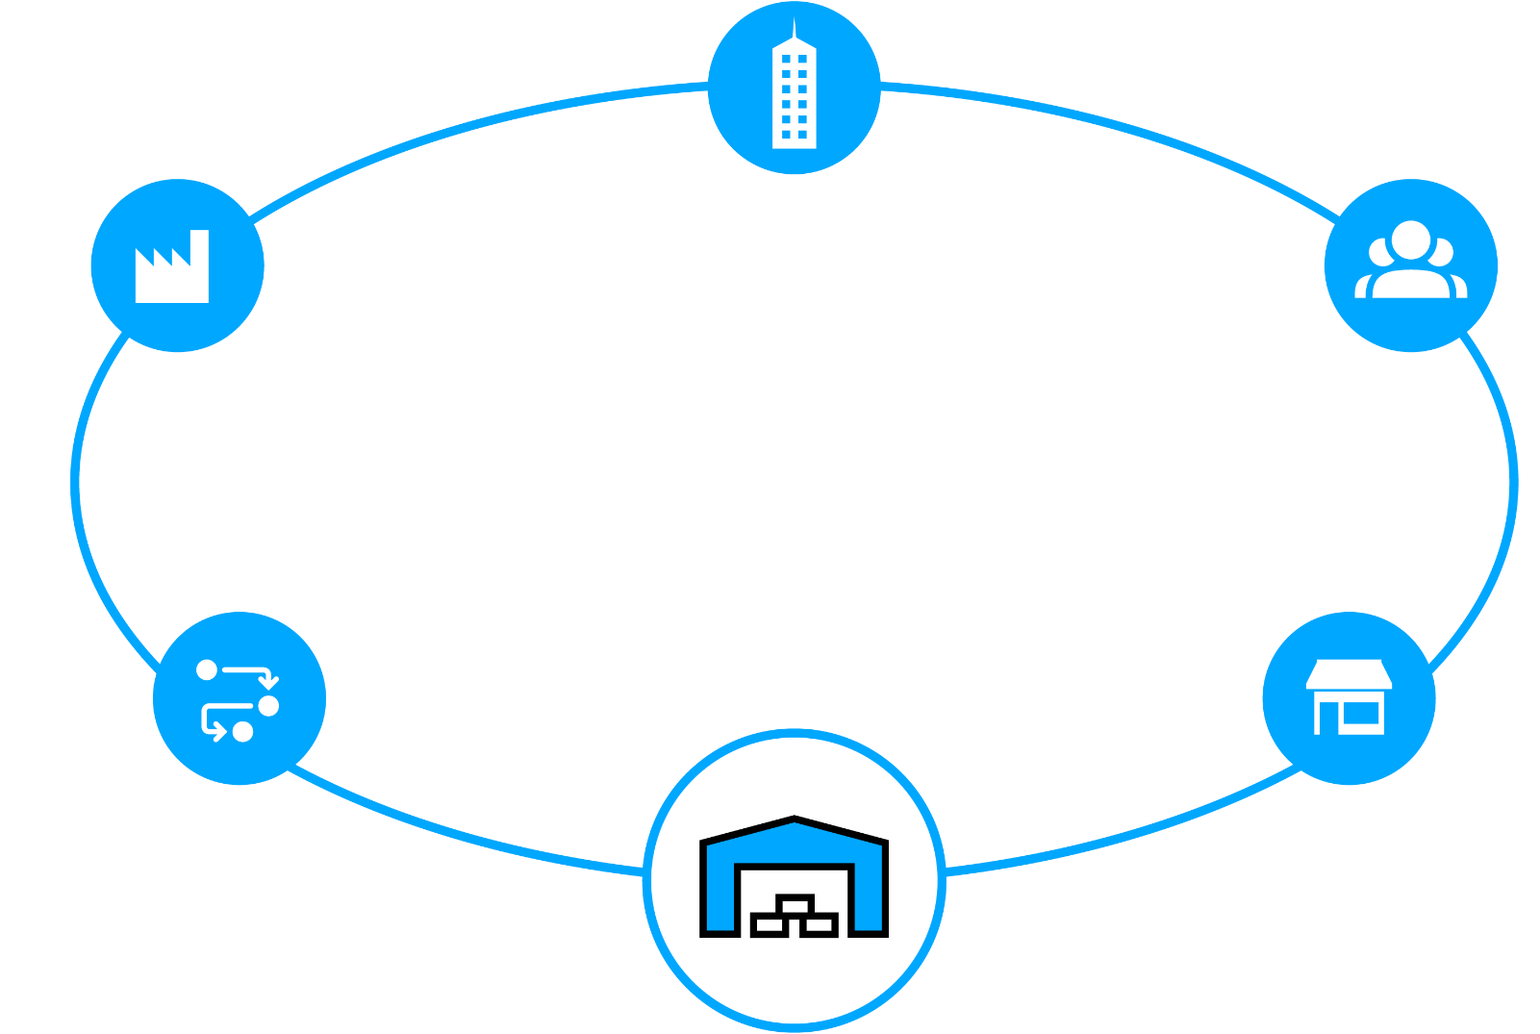


Today’s Supply Chain is Complex
Satisfying customers is no simple matter
Retail or Wholesale Customer
Service and Corporate Operations
New shipping mandates
Suppliers
Raw Materials
Ship direct to customer
Manufacturer
Plant / Warehouse
Finished goods
Customer
Ship to store
Real time
Inventory status
Rush orders
Real time
Inventory status
Real time
item status
Pick-up in
store
Returns
Pallet shipping
Ground orders
Shipment from
closest location
Returns
Real time
Inventory status
Returns
Returns
Real time
Inventory status
Real time
Inventory status
Third-Party
Logistics
Store
Ship to store
Warehouse / Distribution Center / Fulfillment Center

Slide 4

Warehouse Operations
Must Keep Pace
By solving today’s challenges
Isolated systems and visibility gaps
Labor shortages and more volume
  ~50% of all warehouse labor invested in picking operations
Disconnected workers and workflows
  Annual warehouse turnover rates are 30+%
Bottlenecks and asset inventory
blind spots
Rising workflow complexity
Errors and non-compliance are costly
  Onboarding workers may involve a
  90-day ramp up

Slide 5
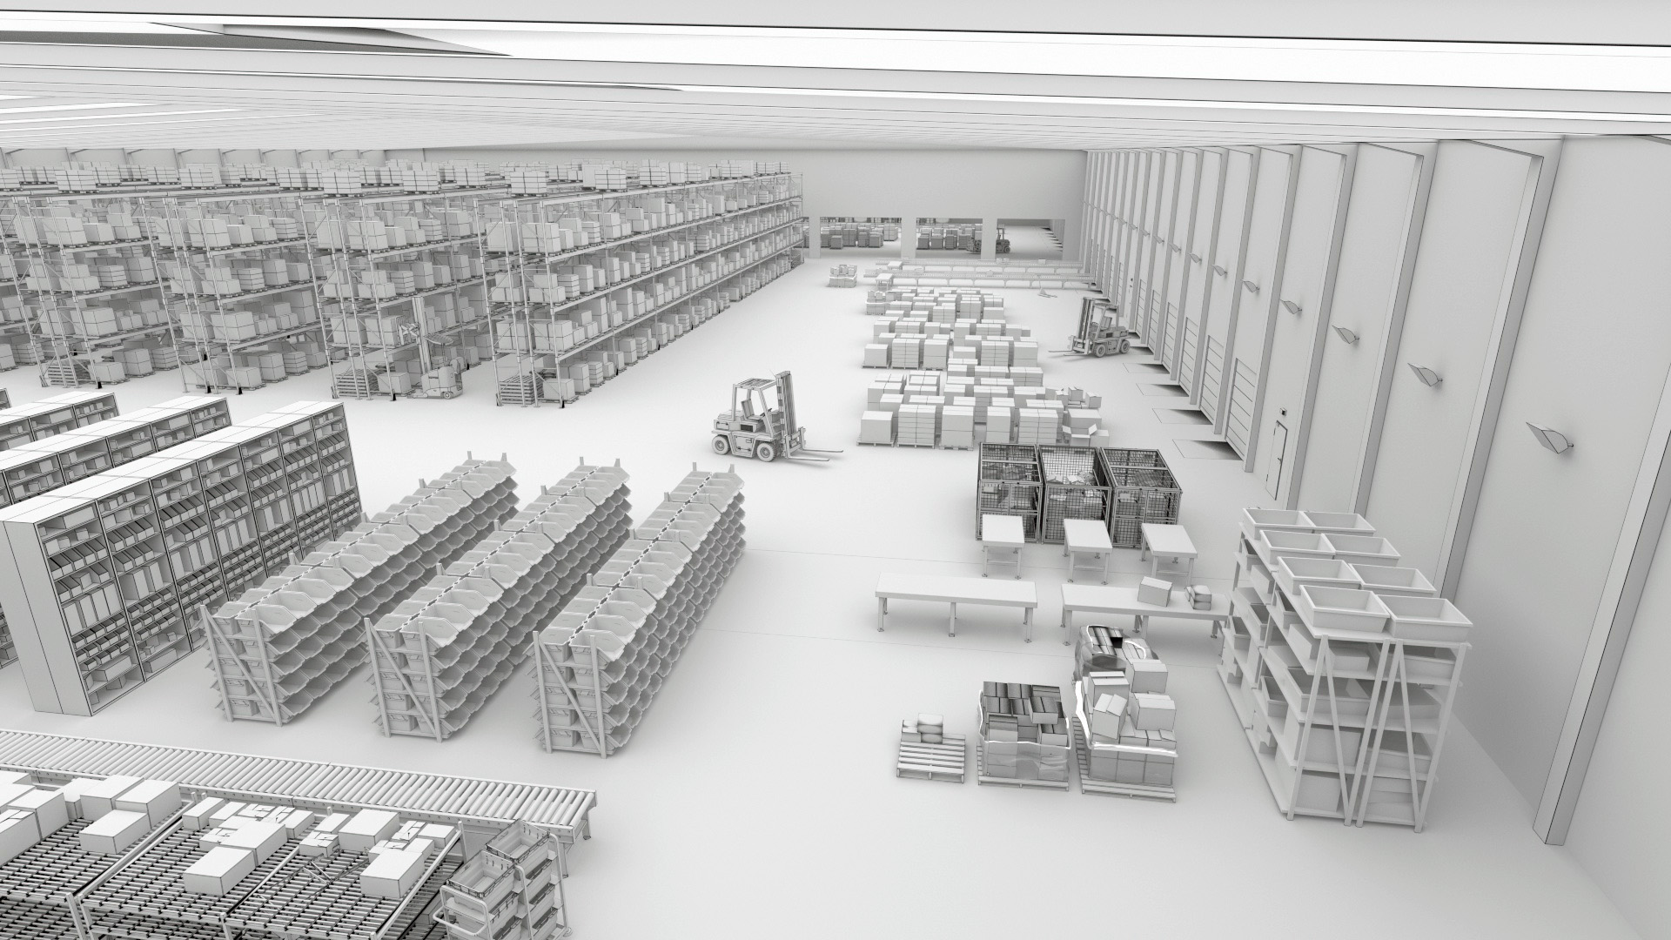
What Do You Need To Solve To Get To Where You Want To Be?
Reduced labor force
Streamlining picking
Turning around
outbound processes
61%
60%
86%
Plan to rely on a combination of humans and technology by 2024
View labor efficiency and productivity as a top challenge
Plan to increase volume of items shipped by 2024
Reducing inbound
congestion
Swiftly handling returns
83%
81%
Plan to have Increased number of SKUs by 2024
Plan to expand
returns management operations by 2024
Warehousing Vision Study, Zebra Technologies, 2019.

Slide 6
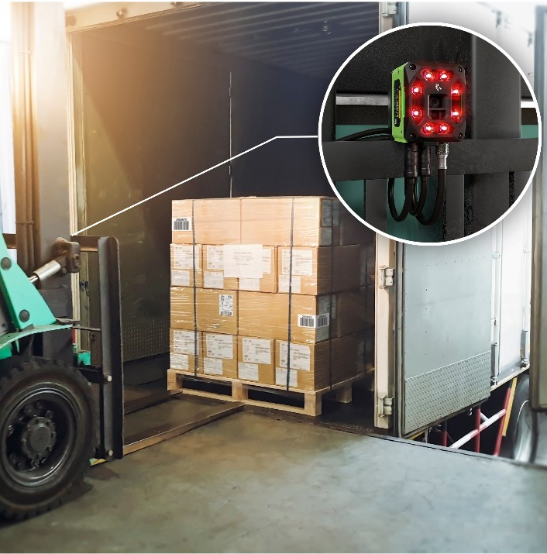
Zebra Warehouse Solutions: Forklift Scanning
How does it work?
Two fixed industrial scanners or smart cameras are mounted on the front of the forklift between its tines, acting as the eyes of the vehicle
  Hands-free scanning streamlines the scan process
When the forklift approaches a pallet, the scanners automatically scan labels and transmit the captured data to the forklift’s onboard computer
  This saves time, reduces read errors and misloads and improves loading efficiency and shipping volume
  Scanners also connect directly to handheld devices, vehicle-mount computers or tablets
Data transfer is wired or wireless,
depending on region and unique
installation requirements

Slide 7
Zebra Warehouse Solutions: Forklift Scanning
What can it help you achieve?
Better inventory accuracy: Machine vision-equipped forklifts automatically capture data from barcodes, RFID tags, or visual cues, reducing need for manual documentation and improving inventory accuracy
Picking and putaway efficiency: Forklift operators need to locate, pick, and put away items quickly. Machine vision technology guides operators to the precise location of items, improving picking and putaway efficiency and reducing the likelihood of errors
Labor reduction and cost savings: Forklift scanners reduce the need for manual inspection and handling, leading to cost savings and increased processing speeds
Fewer operational errors: Reduced human intervention improves data quality and accuracy, and streamlines operations

Slide 8
Why Choose Zebra To Build Your Forklift Scanner?
How our solutions stand apart
Proven high-speed barcode reading with unmatched accuracy that improves efficiency and overall throughput
Powerful software to read and decode OCR, barcodes, dimensional information and label defects
Cost effective, customizable solutions
Rugged design to sustain harsh environments and reduce maintenance and down-time
Innovative sensors and smart cameras available in various sizes to accommodate any field of view
Seamless integration with existing automation equipment
Easily pair with other Zebra devices such as mobile computers and industrial printers for a single-source solution
Trust an award-winning partner ecosystem who are experts in vison technology

Slide 9
Boosting Warehouse Productivity With Zebra
Benefits of our forklift scanning solutions
Savings valued at up to 3x the investment after 6 months, for an exceptional return on investment
Shorter ramp-up time with default out-of-the-box software settings that reduce the learning curve and ensure faster deployments every time
SR and WA lens options optimized to handle 80% of warehouse use cases, reducing the number of configurations the customer needs to purchase and manage
Easier troubleshooting and optimization with features like Golden Image Compare and a feasibility setup assistant. Minimize downtime and ensures that captured images meet best practice metrics, leading to more efficient operations
IP65 and IP67 ratings for scanners and sensors are optimized for challenging environments seen in warehouses, distribution centers and manufacturing plants
Top-of-the-line optical quality—enhanced to assess barcode quality and ensure superior image quality at label edges—enables verification and optical character recognition via a simple software license

Slide 10
The Sure Path to Smarter Warehousing
From gaining basic control of operations to achieving predictability and
adaptability, let us help guide your journey with a new standard for accelerating warehouse modernization
Your way forward starts with:
1
Decades of field-proven innovation in warehousing
An outcome-driven approach based on your strategic journey
A focus on continuous improvement of your business
A comprehensive portfolio to configure the right technology solution for your operations
An extensive partner network to support every aspect of your journey—as you control and set the pace
2
3
4
5

Slide 11
For more information, please contact XXX / visit zebra.com to learn more

Slide 13
APPENDIX
Product-specific slides if needed

Slide 14
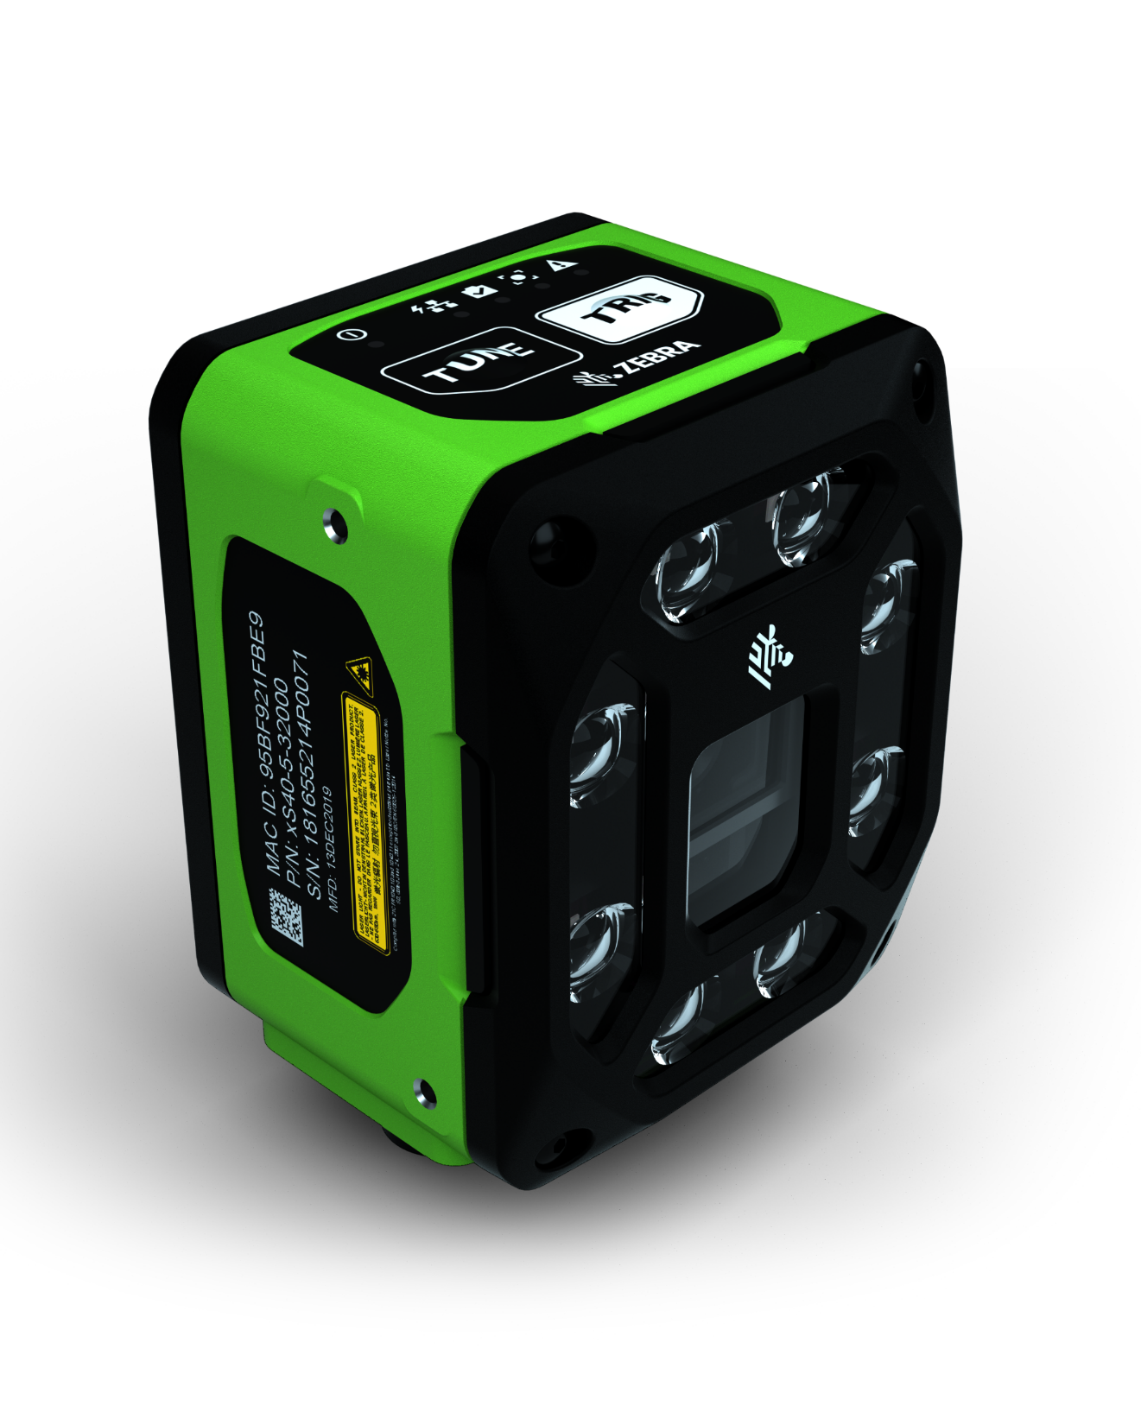
Building Your Forklift Scanner
FS40 fixed industrial scanners
First-time every-time capture of barcodes and DPMs in any condition at high speeds
Pair with Zebra Aurora Focus™ software to set up, control and run the device
Easy license upgrades to add on decoder packages and machine vision toolsets to build your folklift scanning solution
PoE connectivity to reduce need for peripheral equipment

Slide 15
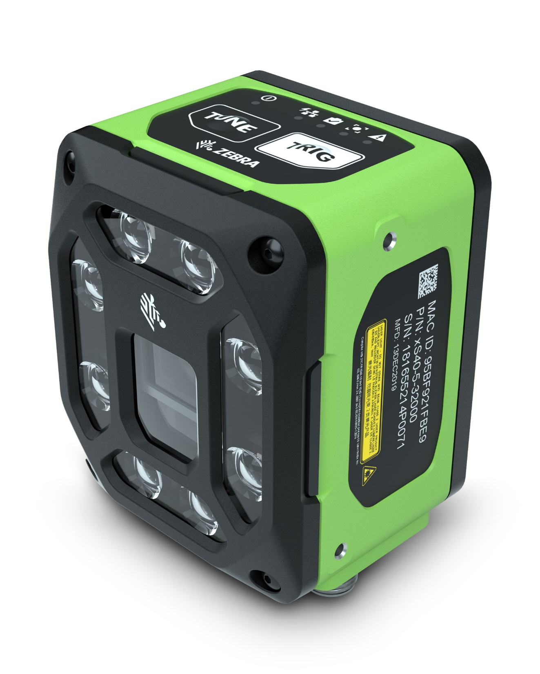
Building Your Forklift Scanner
VS40 smart cameras
Capture up to 16 unique high-speed images with ImagePerfect+ and eliminate false rejects
Troubleshoot failed image captures immediately with Golden Image Compare
Pair with Aurora Focus software to set up, control and run the device
Upgradeable software to easily add support for new symbologies, faster speeds or machine vision toolsets

Slide 16

Building Your Forklift Scanner
Aurora Focus software
Ready-made for barcode reading and verification, OCR, and presence/absence vision inspection
  Purpose-built to scan and compare barcodes to determine code quality and assess if quality impacts scan ability
Deploy directly from FS scanners and VS smart cameras
Intuitive interface designed to make it easy to build, deploy and adjust jobs, and configure scanner connections

