Slide 1
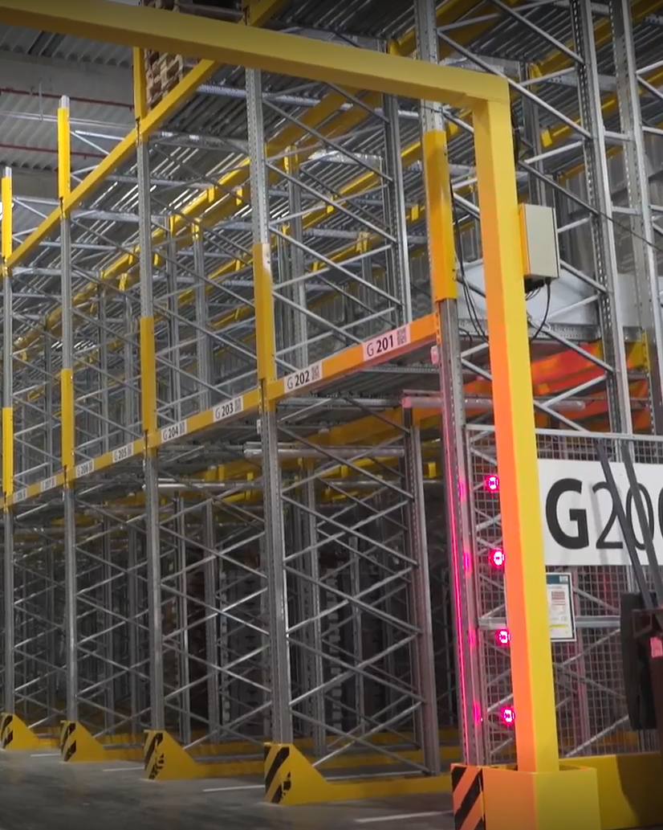
Zebra Warehouse Solutions
Dock Door Scanning

Slide 2

Agenda
Zebra warehouse solutions: Dock door scanning
Challenges in the warehouse
  Today’s supply chain is complex
  Warehouse operations must keep pace
  What do you need to solve to get to where you want to be?
Dock doors
  How do they work? What can they help you achieve?
Why choose Zebra to build your dock door?
  How our solutions stand apart
  Benefits of our dock door solutions
The sure path to smarter warehousing

Slide 3
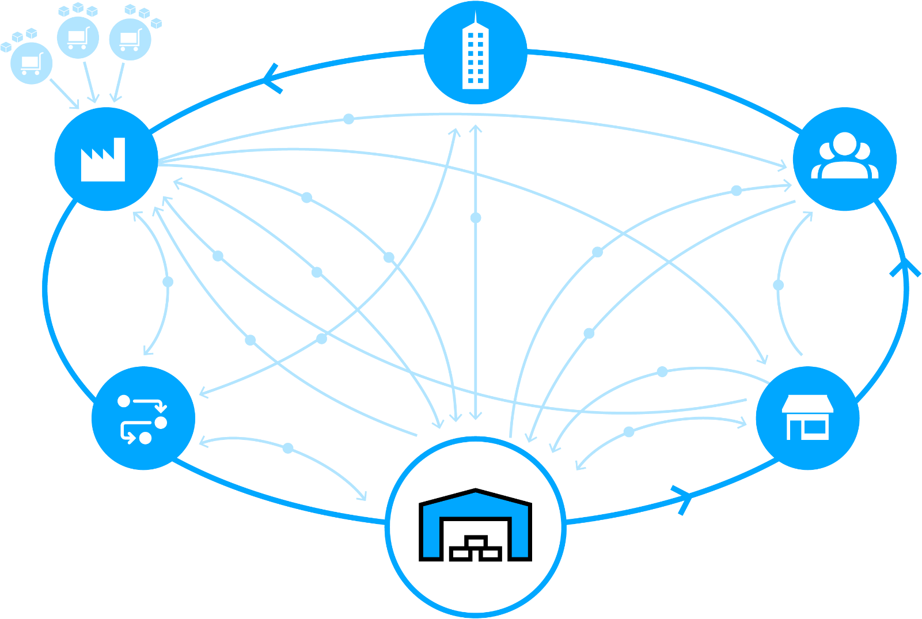
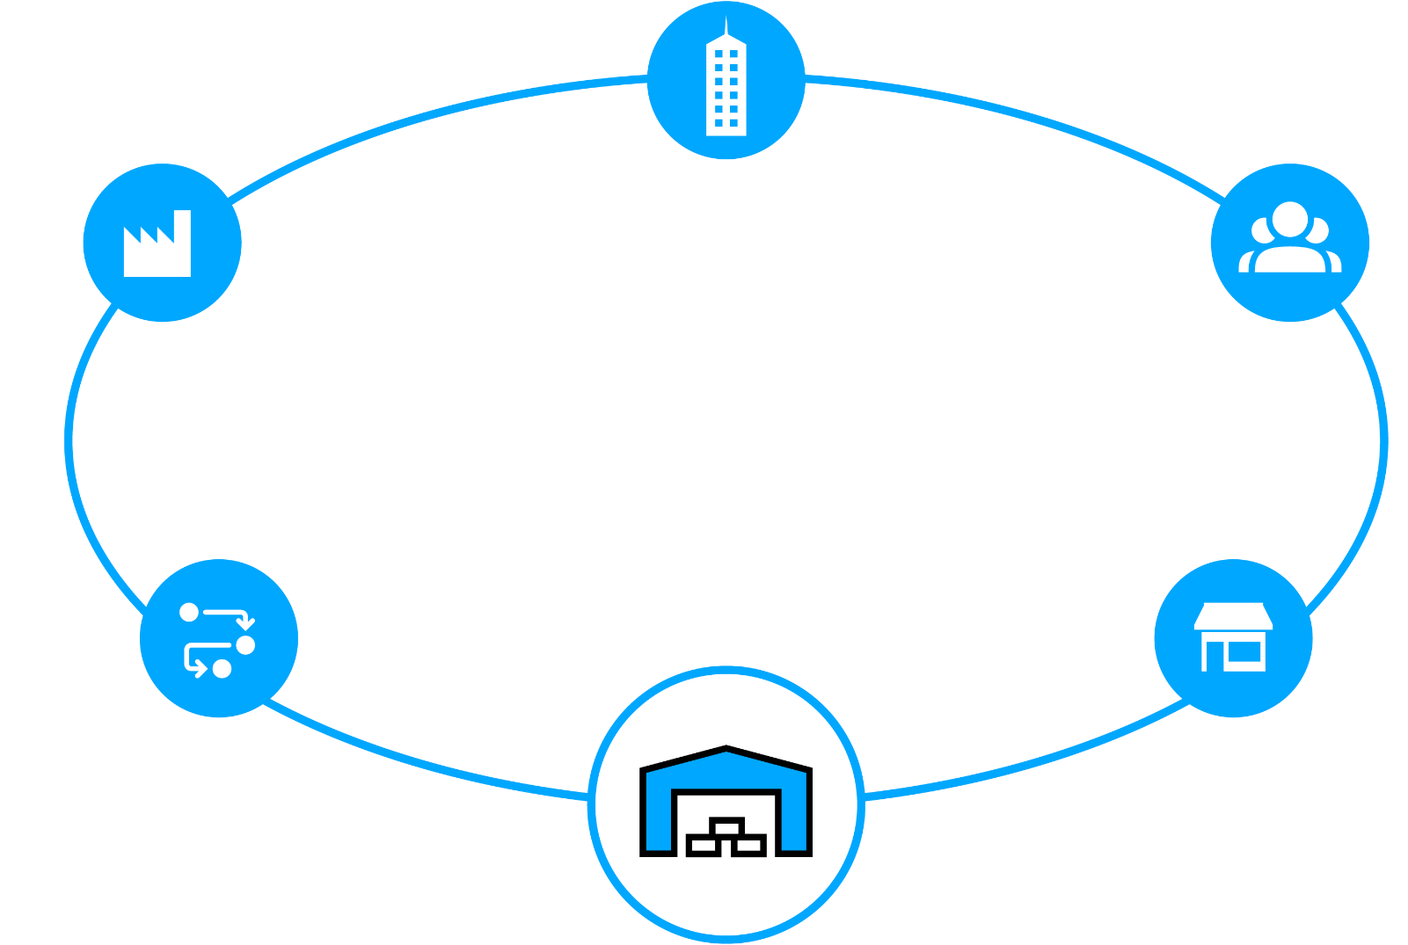


Today’s Supply Chain is Complex
Satisfying customers is no simple matter
Retail or Wholesale Customer
Service and Corporate Operations
New shipping mandates
Suppliers
Raw Materials
Ship direct to customer
Manufacturer
Plant / Warehouse
Finished goods
Customer
Ship to store
Real time
Inventory status
Rush orders
Real time
Inventory status
Real time
item status
Pick-up in
store
Returns
Pallet shipping
Ground orders
Shipment from
closest location
Returns
Real time
Inventory status
Returns
Returns
Real time
Inventory status
Real time
Inventory status
Third-Party
Logistics
Store
Ship to store
Warehouse / Distribution Center / Fulfillment Center

Slide 4
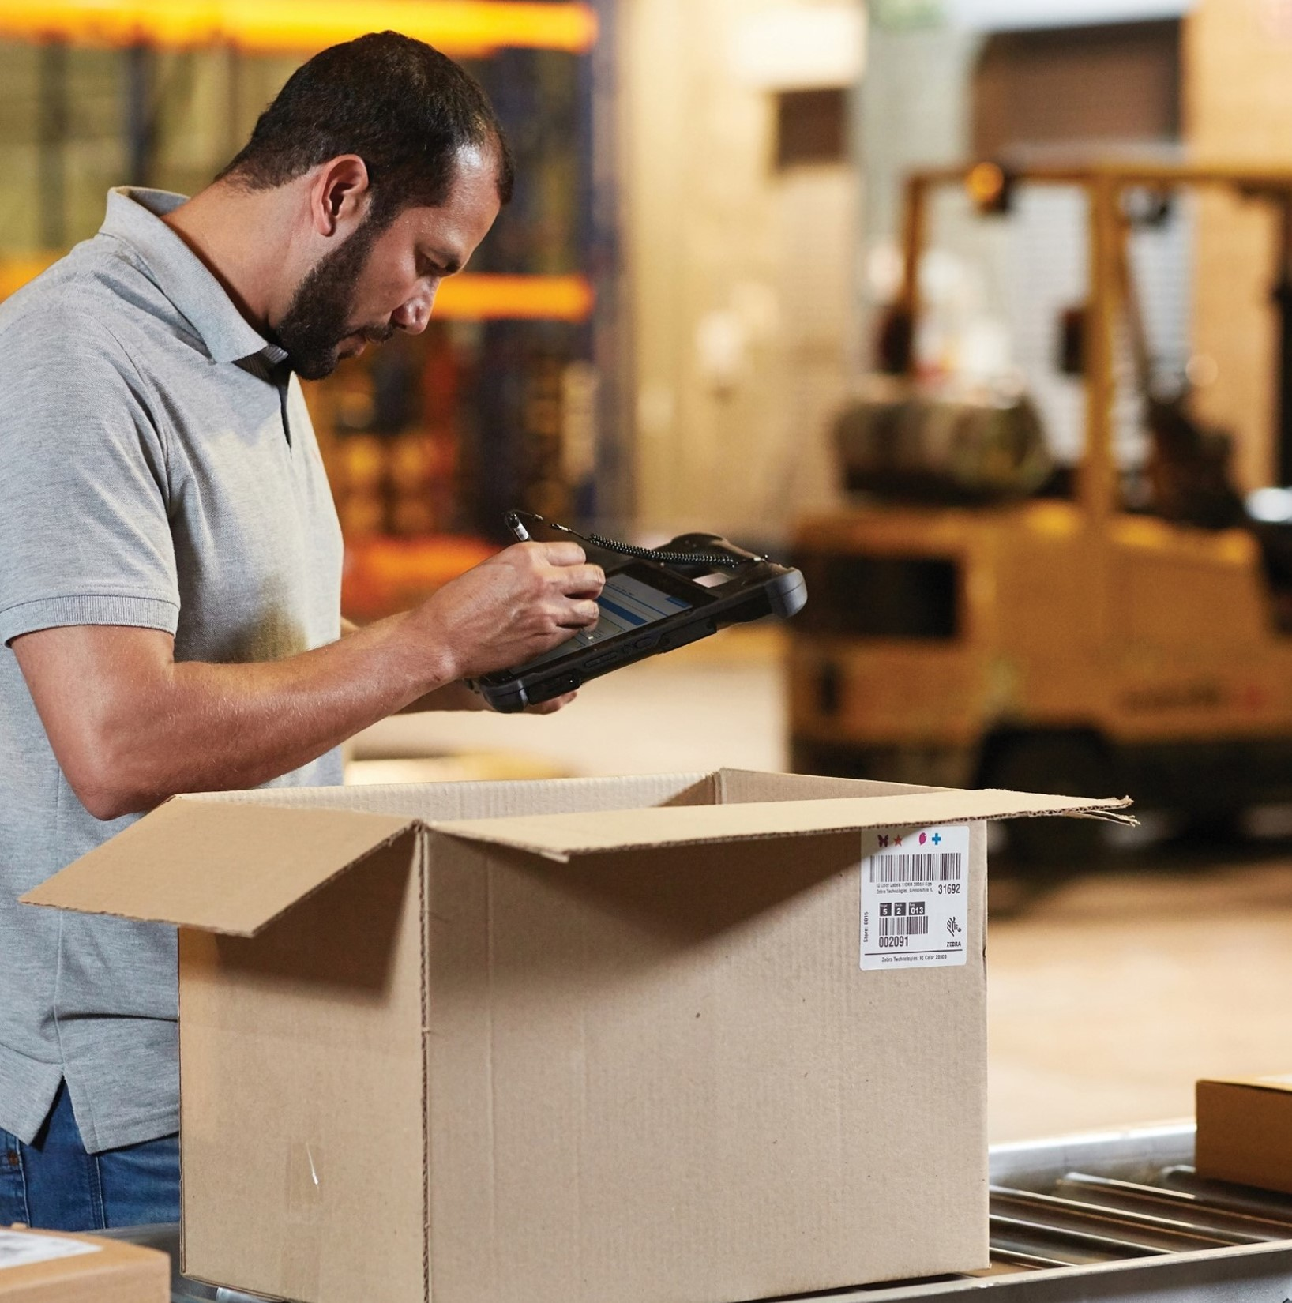
Warehouse Operations
Must Keep Pace
By solving today’s challenges
Isolated systems and visibility gaps
Labor shortages and more volume
  ~50% of all warehouse labor invested in picking operations
Disconnected workers and workflows
  Annual warehouse turnover rates are 30+%
Bottlenecks and asset inventory
blind spots
Rising workflow complexity
Errors and non-compliance are costly
  Onboarding workers may involve a
  90-day ramp up

Slide 5
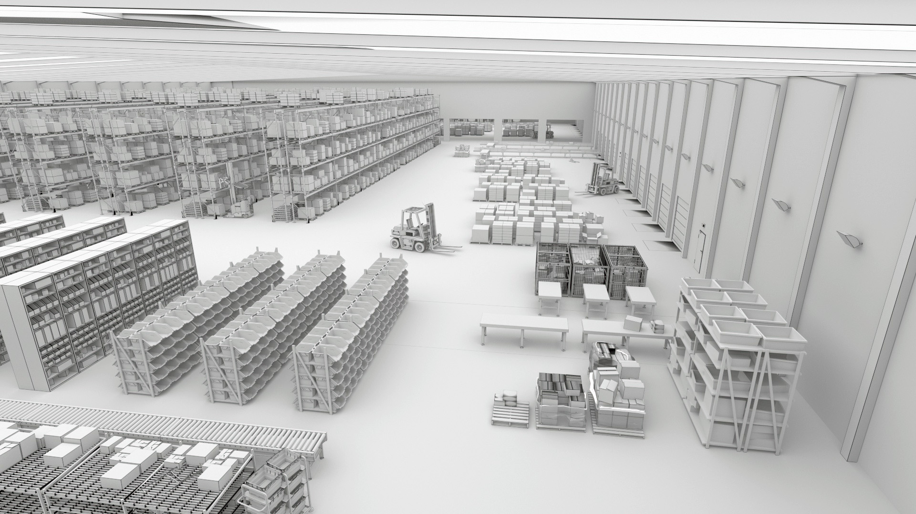
What Do You Need To Solve To Get To Where You Want To Be?
Reduced labor force
Streamlining picking
Turning around
outbound processes
61%
60%
86%
Plan to rely on a combination of humans and technology by 2024
View labor efficiency and productivity as a top challenge
Plan to increase volume of items shipped by 2024
Reducing inbound
congestion
Swiftly handling returns
83%
81%
Plan to have increased number of SKUs by 2024
Plan to expand
returns management operations by 2024
Warehousing Vision Study, Zebra Technologies, 2019.

Slide 6
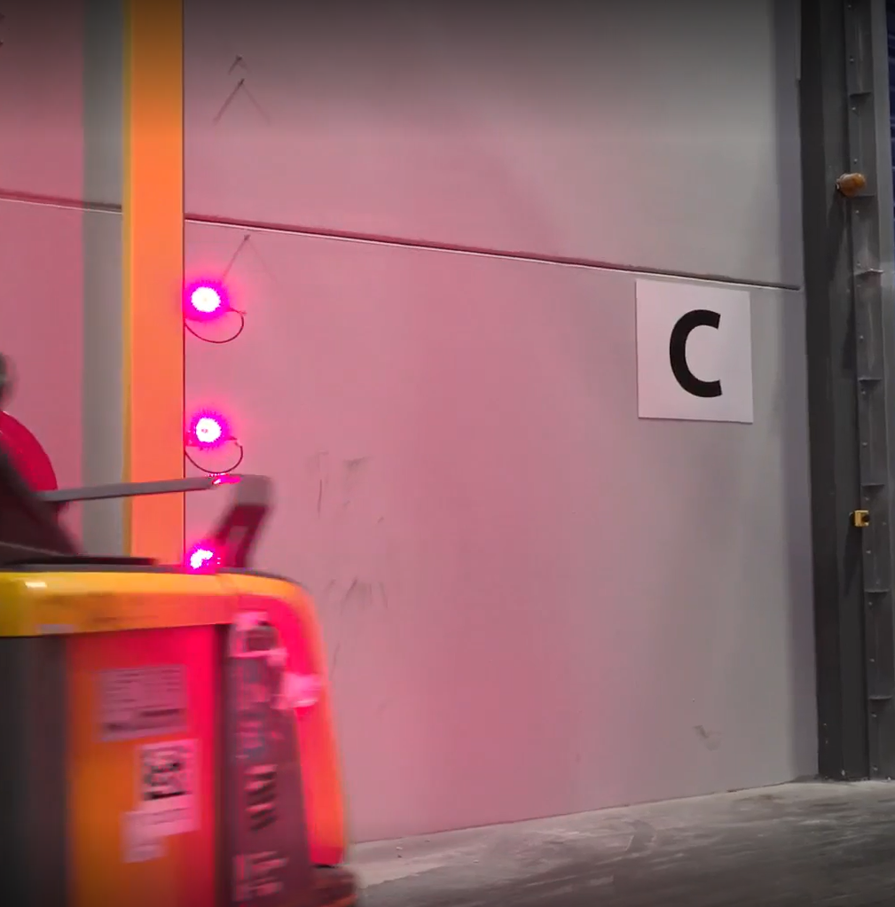
Zebra Warehouse Solutions: Dock Doors
How do they work?
Two fixed industrial scanners are mounted in an arch on either side of the loading door
Forklift passes through the arch and fixed scanners capture barcode data at high speeds
  Data is relayed to the forklift’s onboard computer, which confirms that the correct pallet is being manipulated
Automated system accurately scans the labels, ultimately saving time and increasing shipping output

Slide 7
Zebra Warehouse Solutions: Dock Doors
What can they help you achieve?
Better inventory accuracy: Dock door scanning helps reduce discrepancies and ensures accurate stock levels
More efficient order fulfillment: Dock door technology enhances order accuracy and speeds up the picking and packing processes
Simplified compliance and reporting: Machine vision technology simplifies data collection and ensures adherence to regulatory requirements, reducing the risk of fines and penalties
Improved operational visibility: Building smarter and more connected environments delivers better visibility to make informed decisions and improve business outcomes
Greater traceability: Fixed industrial scanners automatically identify and capture data on packages, pallets and containers for real-time asset tracking and utilization

Slide 8
Why Choose Zebra To Build Your Dock Door?
How our solutions stand apart
Proven high-speed barcode reading with unmatched accuracy that improves efficiency and overall throughput
Powerful software to read and decode OCR, barcodes, dimensional information and label defects
Cost effective, customizable solutions
Rugged design to sustain harsh environments and reduce maintenance and down-time
Innovative sensors and smart cameras available in various sizes to accommodate any field of view
Seamless integration with existing automation equipment
Easily pair with other Zebra devices such as mobile computers and industrial printers for a single-source solution
Trust an award-winning partner ecosystem who are experts in vison technology

Slide 9
Boosting Warehouse Productivity With Zebra
Benefits of our dock door solutions
Savings valued at up to 3x the investment after 6 months, for an exceptional return on investment
ImagePerfect+ captures 16 data points from a single trigger, saving time and resources
Liquid lenses offer technological advantages over traditional mechanical lenses. Designed to focus across variable working distances, liquid lens facilitate the use of ImagePerfect+ and deliver dependably high read rates
Shorter ramp-up time with default out-of-the-box software settings that reduce the learning curve and ensure faster deployments every time
SR and WA lens options optimized to handle 80% of warehouse use cases, reducing the number of configurations the customer needs to purchase and manage
IP65 and IP67 ratings for scanners and sensors are optimized for challenging environments seen in warehouses, distribution centers and manufacturing plants

Slide 10
The Sure Path to Smarter Warehousing
From gaining basic control of operations to achieving predictability and
adaptability, let us help guide your journey with a new standard for accelerating warehouse modernization
Your way forward starts with:
1
Decades of field-proven innovation in warehousing
An outcome-driven approach based on your strategic journey
A focus on continuous improvement of your business
A comprehensive portfolio to configure the right technology solution for your operations
An extensive partner network to support every aspect of your journey—as you control and set the pace
2
3
4
5

Slide 11
For more information, please contact XXX / visit zebra.com to learn more

Slide 13
APPENDIX
Product-specific slides if needed

Slide 14
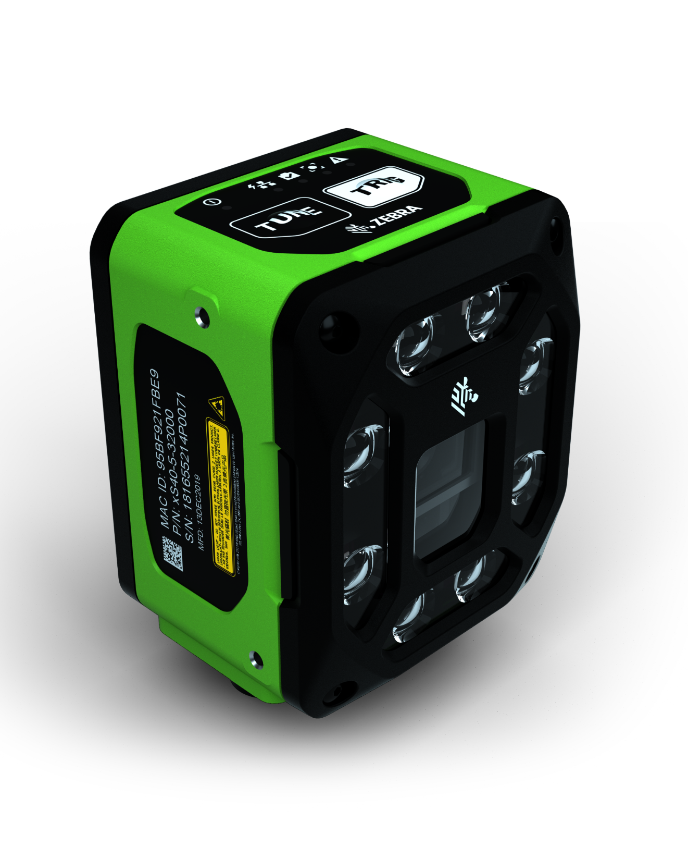
Building Your Dock Door
FS40 fixed industrial scanners
First-time every-time capture of barcodes and DPMs in any condition at high speeds
Pair with Zebra Aurora Focus™ software to set up, control and run the device
Easy license upgrades to add on decoder packages and machine vision toolsets to build your dock door solution
PoE connectivity to reduce need for peripheral equipment

Slide 15
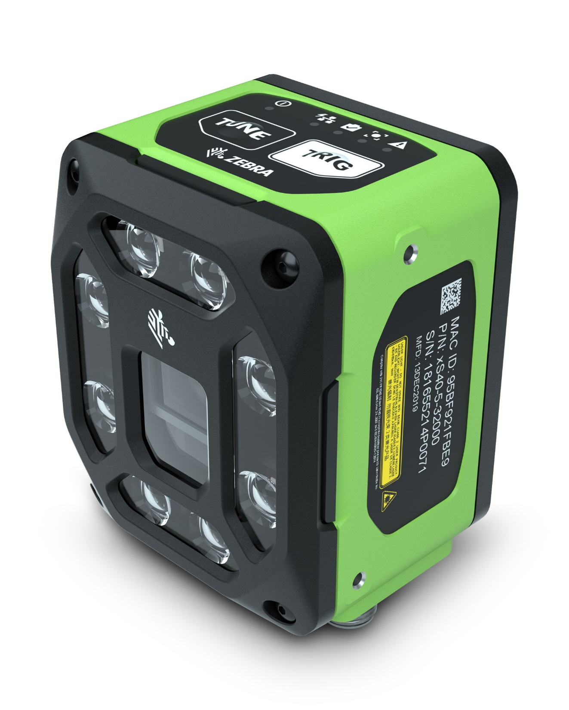
Building Your Dock Door
VS40 smart cameras
Capture up to 16 unique high-speed images with ImagePerfect+ and eliminate false rejects
Troubleshoot failed image captures immediately with Golden Image Compare
Pair with Aurora Focus software to set up, control and run the device
Upgradeable software to easily add support for new symbologies, faster speeds or machine vision toolsets

Slide 16

Building Your Dock Door
Aurora Focus software
Ready-made for barcode reading and verification, OCR, and presence/absence vision inspection
  Purpose-built to scan and compare barcodes to determine code quality and assess if quality impacts scan ability
Deploy directly from FS scanners and VS smart cameras
Intuitive interface designed to make it easy to build, deploy and adjust jobs, and configure scanner connections

