Slide 1

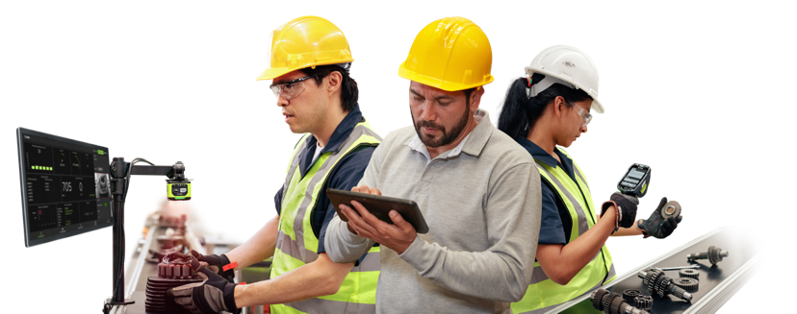
Work in Process (WIP) Tracking
Industry:
Manufacturing
Elevator Pitch:
By automating and digitizing the tracking of work-in-process assets, from raw materials to finished goods, you enhance visibility significantly. This not only boosts production throughput and allows for faster resolution of bottlenecks, but also improves assembly accuracy, reduces scrap, and transforms traceability for regulatory compliance and advanced customer insights. In addition, you’ll enhance worker productivity, enabling the upskilling of your existing workforce.
Products:
RFID, Tablets
Personas
Plant Operations, Engineering, Quality, Innovation, Digitalization
Expected Outcomes:
Manufacturers can locate and track the movement and progress of every asset at every stage.
Global Network
of Partners
RFID Specialists, Manufacturing Execution Systems (MES),
Plant Floor Solutions Partners, Independent Software Vendors
Track the availability of raw materials inventory to facilitate restocking and keep stock levels on target
Identify and resolve bottlenecks, minimizing downtime and maximizing production throughput
Know the location and status of orders in production and transit, optimizing supply chain logistics
Reduce errors and minimize waste to improve efficiency and achieve prioritized KPIs
Improve worker productivity to execute higher value tasks
Customer Success Story:
G3 Boats
Customer Pain Points:
Manufacturers lack visibility into WIP asset tracking, because they rely on manual product searches and manual data entry.
Inability to share accurate and timely updates which reduces visibility across the value chain
Challenges with reducing errors upstream and overall
Reduced productivity due to time-intensive and inconsistent data capture
Inability to anticipate bottlenecks, downtime and delays

