Slide 1
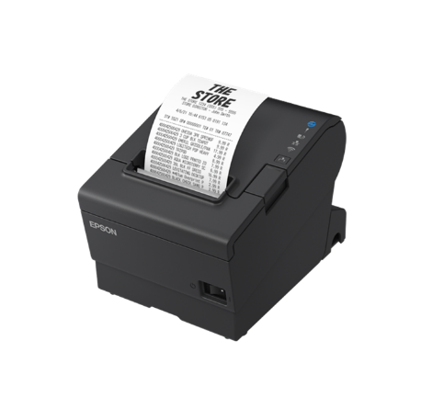
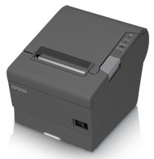
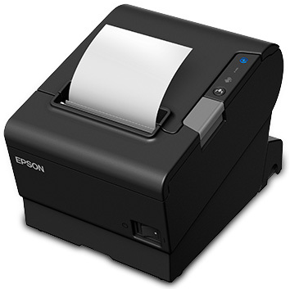
T88V vs T88VI vs T88VII Comparison
TM-T88 Comparison
 | Model | T88V | T88VI | New T88VII
Key Features | Maximum Print Speed | 300mm/s | 350mm/s | 500mm/s
 | Warranty | 4yrs | 4 yrs | 4 yrs
 | Thermal Head Reliability | 150km | 200km | 200km
 | Autocutter Reliability | 2m cuts | 3m cuts | 3m cuts
 | Online Order Ready¹ | No | Yes | Yes
 | Connect-it UIB Interface Option | Yes | Yes | Yes
 | Fixed Interface Option (USB + Eth + 2 USB-A Ports) | No | No | Yes
 | NFC | No | Yes | Yes
 | USB-A Ports (Peripheral Device Support) | 0 | 1 | Up to 2
 | Improved Case and LEDs | No | No | Yes
1 Through use of Epson Server Direct Print technology

